Slide 1
What's So Good About the Choctaw Church of Christ?
MIKE MAZZALONGO

Slide 3
I complain because I see only what I want to see, instead of seeing what is.

Slide 4
I have the Leadership Lunch when I forget:
Elders are human beings

Slide 5
I have the Leadership Lunch when I forget:
Elders are human beings
Grumbling and complaining are of the “flesh”

Slide 6
The true Christian response to disappointment and frustration is prayer.

Slide 7
… the strength of your faith is more important than the strength of your ideas.

Slide 8
I have the Leadership Lunch when:
Elders are human beings
Grumbling and complaining are of the “flesh”
I forgot to focus on the good because complaining is easier

Slide 9
What’s so Good about the Choctaw Church of Christ?
We have the correct biblical goal.

Slide 10
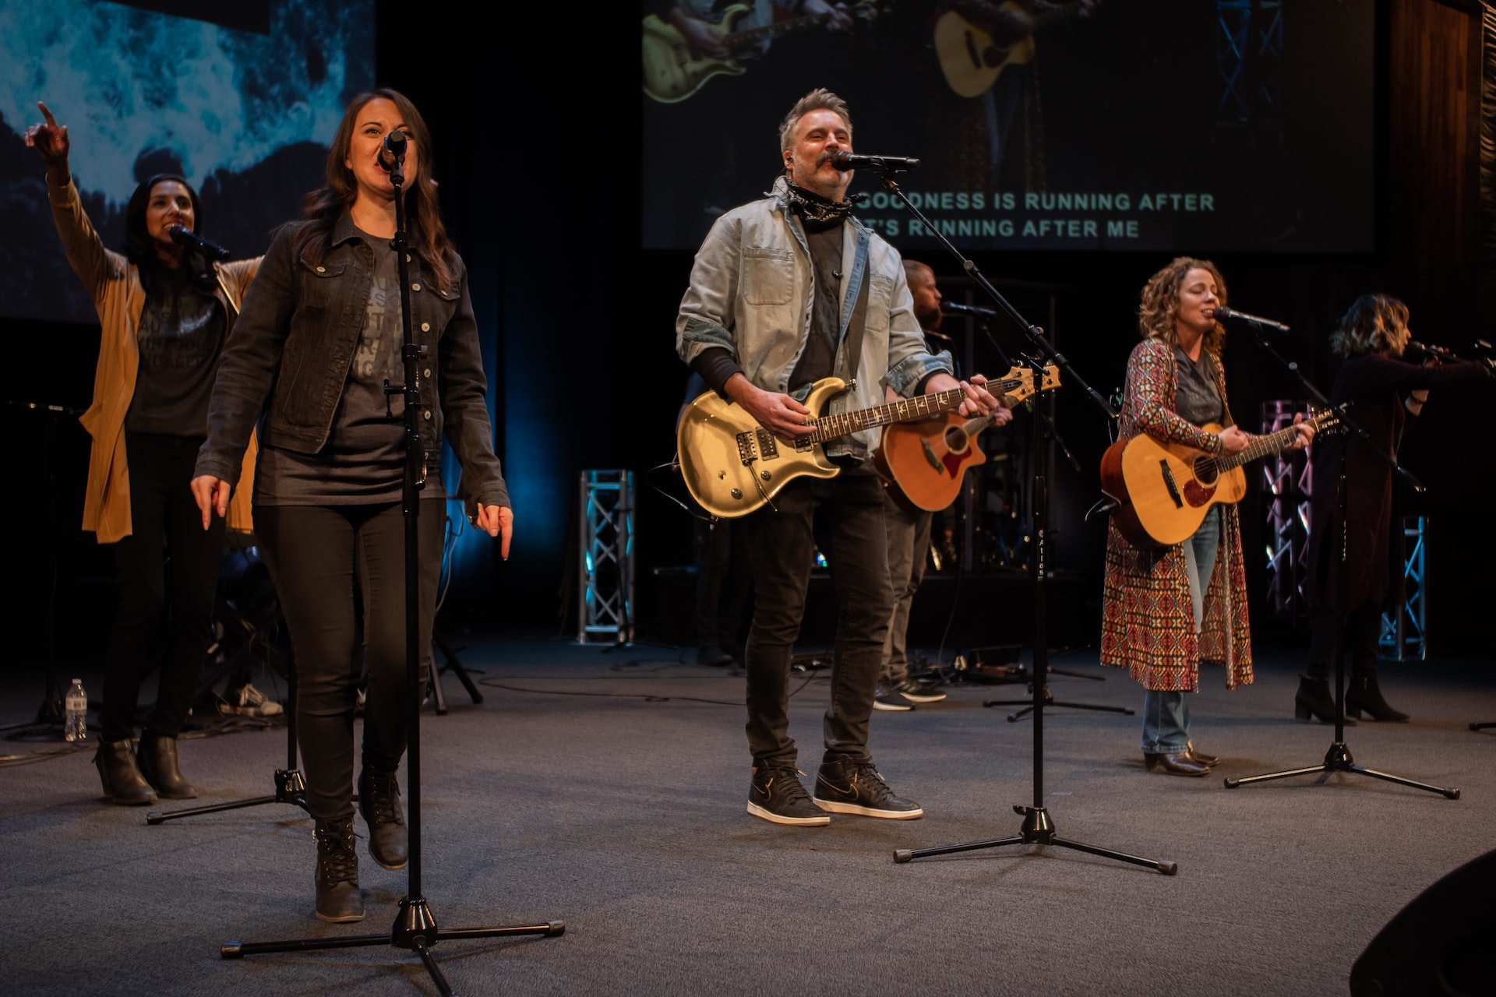

Slide 11
OUR GOAL To be a faithful New Testament Church.

Slide 12
But the one who endures to the end will be saved.
- Matthew 24:13

Slide 13
Go therefore and make disciples of all nations, baptizing them in the name of the Father and of the Son and of the Holy Spirit,
- Matthew 28:19

Slide 14
CHOCTAW CHURCH OF CHRIST
1939
2023

Slide 15
Jesus is searching for a faithful church, not a big church.

Slide 16
What’s so Good about the Choctaw Church of Christ?
We have the correct biblical goal.
We have kept the great commission.

Slide 17
Preach what Jesus preached.
Making disciples as Jesus made disciples.
FAITHFULNESS =

Slide 18
Choctaw Evangelism - 2022
LOCAL Choctaw
DOMESTIC BibleTalk.tv
INTERNATIONAL
12 Baptisms
23 Baptisms
WBS – 18 Baptisms
HAITI – 19 Baptisms
KENYA – 93 Baptisms
ZIMBABWE – 36 Baptisms

Slide 19
What’s so Good about the Choctaw Church of Christ?
We have the correct biblical goal
We have kept the great commission
We survived COVID

Slide 20
We Survived COVID:
First to offer complete service online

Slide 21
We Survived COVID:
First to offer complete service online
Among the first to return to “live” worship

Slide 22
We Survived COVID:
First to offer complete service online
Among the first to return to “live” worship
Returned to complete schedule early:
Hired a Youth/Family minister
Hired an Associate Minister
Added a new mission point
Appointed a Missions Coordinator

Slide 23
Real Results
Gaining new members
Youth group growing
Surpassing budget
More teachers, worship leaders
Younger women stepping up to serve
Constant service from older members

Slide 24
Summary
What distinguishes our church from others is the fact that we strive to be a New Testament church and they don’t.

Slide 25
Present Elders Who Serve
Thanks and appreciation for having faithfully discharged their most important duty – to maintain Choctaw as a faithful New Testament Church.

Slide 26
Future Elders
Your task will be the same as those who came before you and those who will follow after you:
To maintain the Choctaw congregation as a faithful New Testament church until Jesus returns.

Slide 27
Summary
What does the New Testament teach about salvation?
He who has believed and has been baptized shall be saved; but he who has disbelieved shall be condemned. - Mark 16:16

Slide 28
If this has not been your experience, you have not followed Jesus’ explicit teaching concerning your salvation.

