Slide 1
What Heaven is Like
MIKE MAZZALONGO /
II PETER 3:10-13; REVELATION 21:1-2

Slide 2
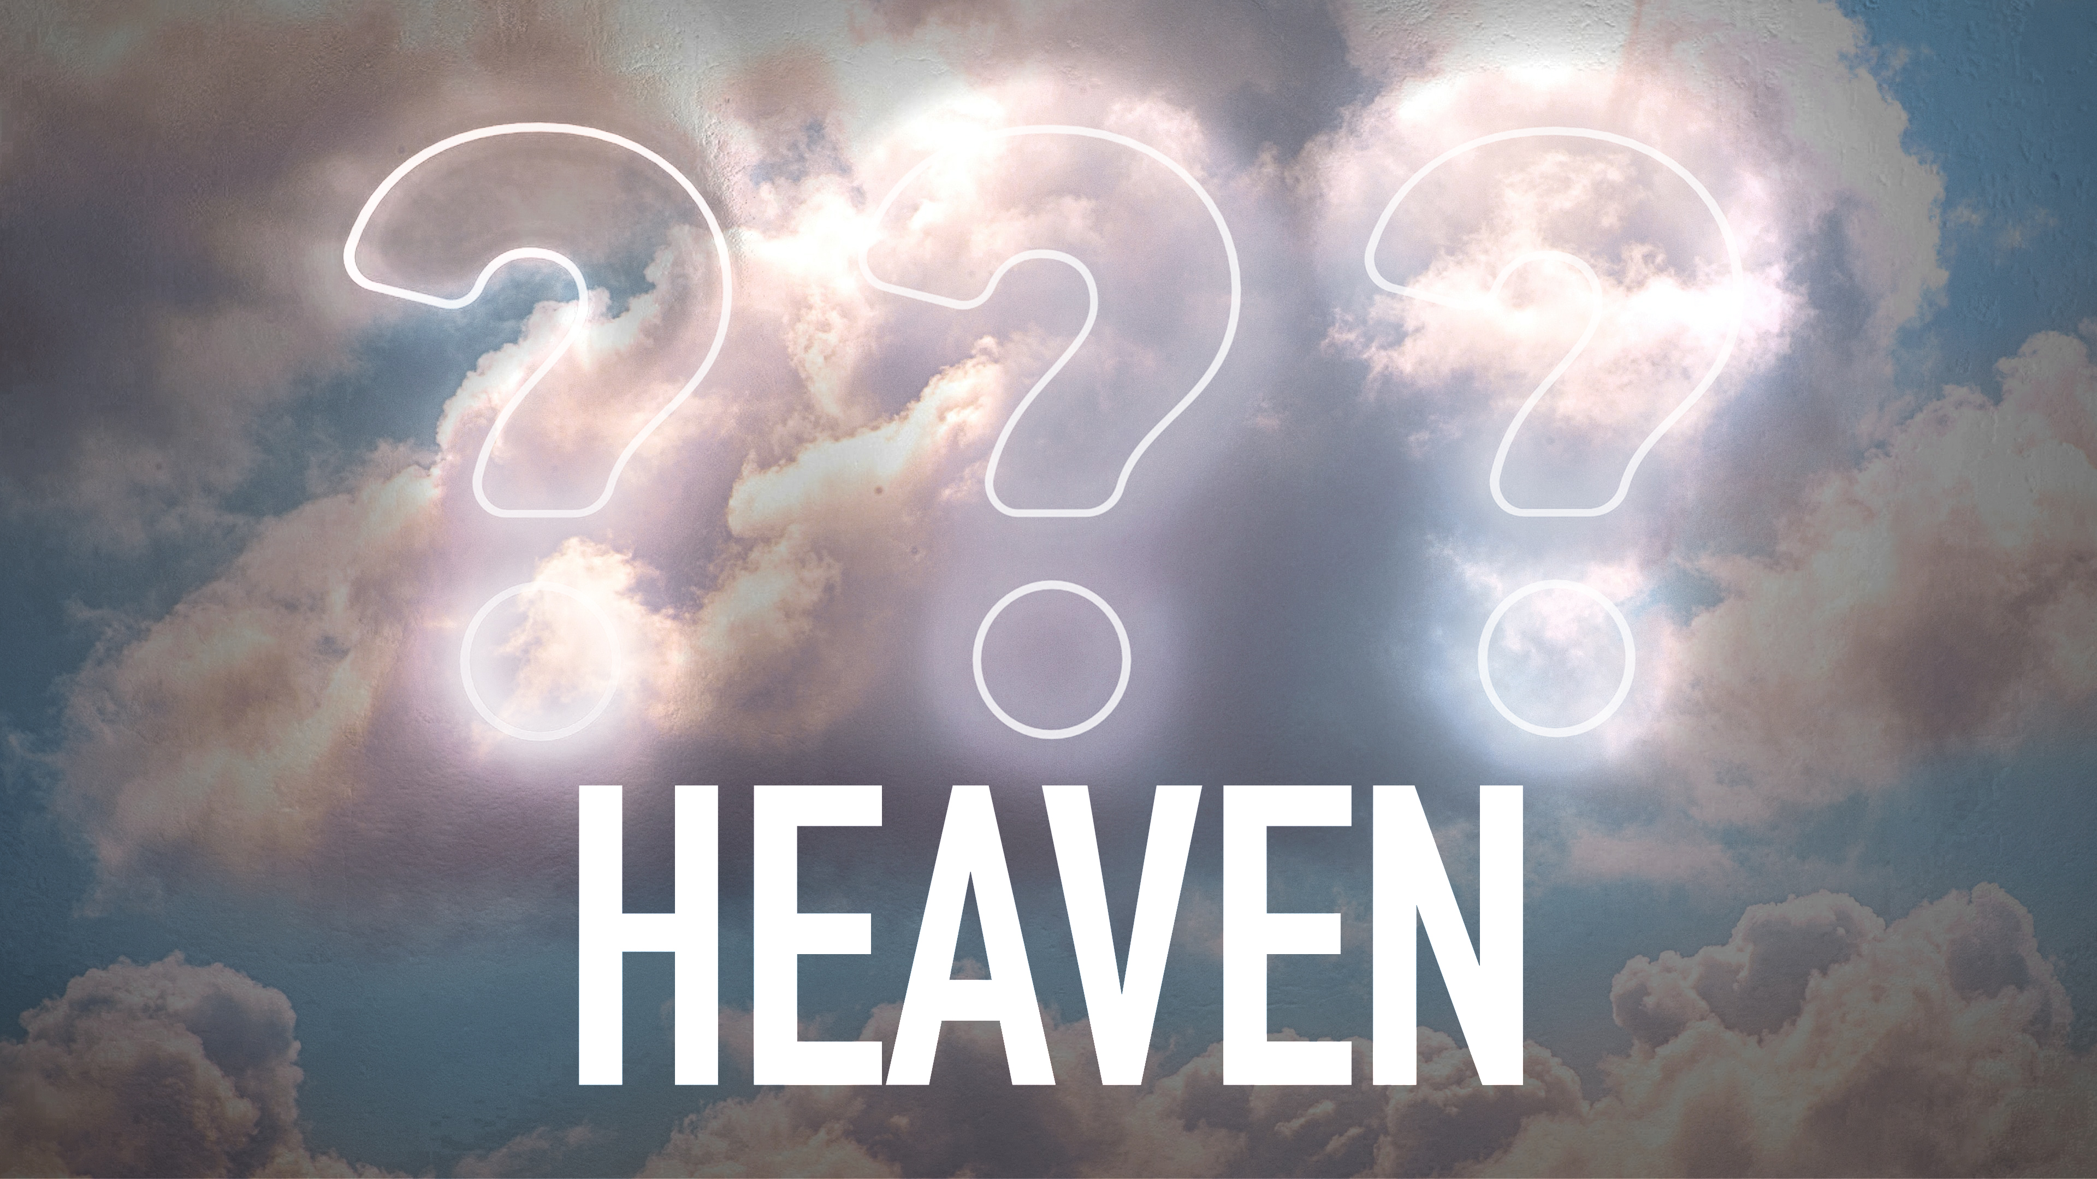

Slide 3
Non-Christian Concepts
Materialism – Heaven is here

Slide 4
Non-Christian Concepts
Materialism – Heaven is here
Existentialists – Heaven is what you make it

Slide 5
Non-Christian Concepts
Materialism – Heaven is here
Existentialists – Heaven is what you make it
Far Eastern Religions – Heaven is harmony

Slide 6
Non-Christian Concepts
Materialism – Heaven is here
Existentialists – Heaven is what you make it
Far Eastern Religions – Heaven is harmony
Eastern Religions – Heaven is oblivion

Slide 7
Non-Christian Concepts
Materialism – Heaven is here
Existentialists – Heaven is what you make it
Far Eastern Religions – Heaven is harmony
Eastern Religions – Heaven is oblivion
Near Eastern Religions – Heaven is Eden

Slide 8
Limits of Old Testament Understanding
No concept of eternity

Slide 9
Limits of Old Testament Understanding
No concept of eternity
Little post-death revelation

Slide 10
Limits of Old Testament Understanding
No concept of eternity
Little post-death revelation
No resurrected persons

Slide 11
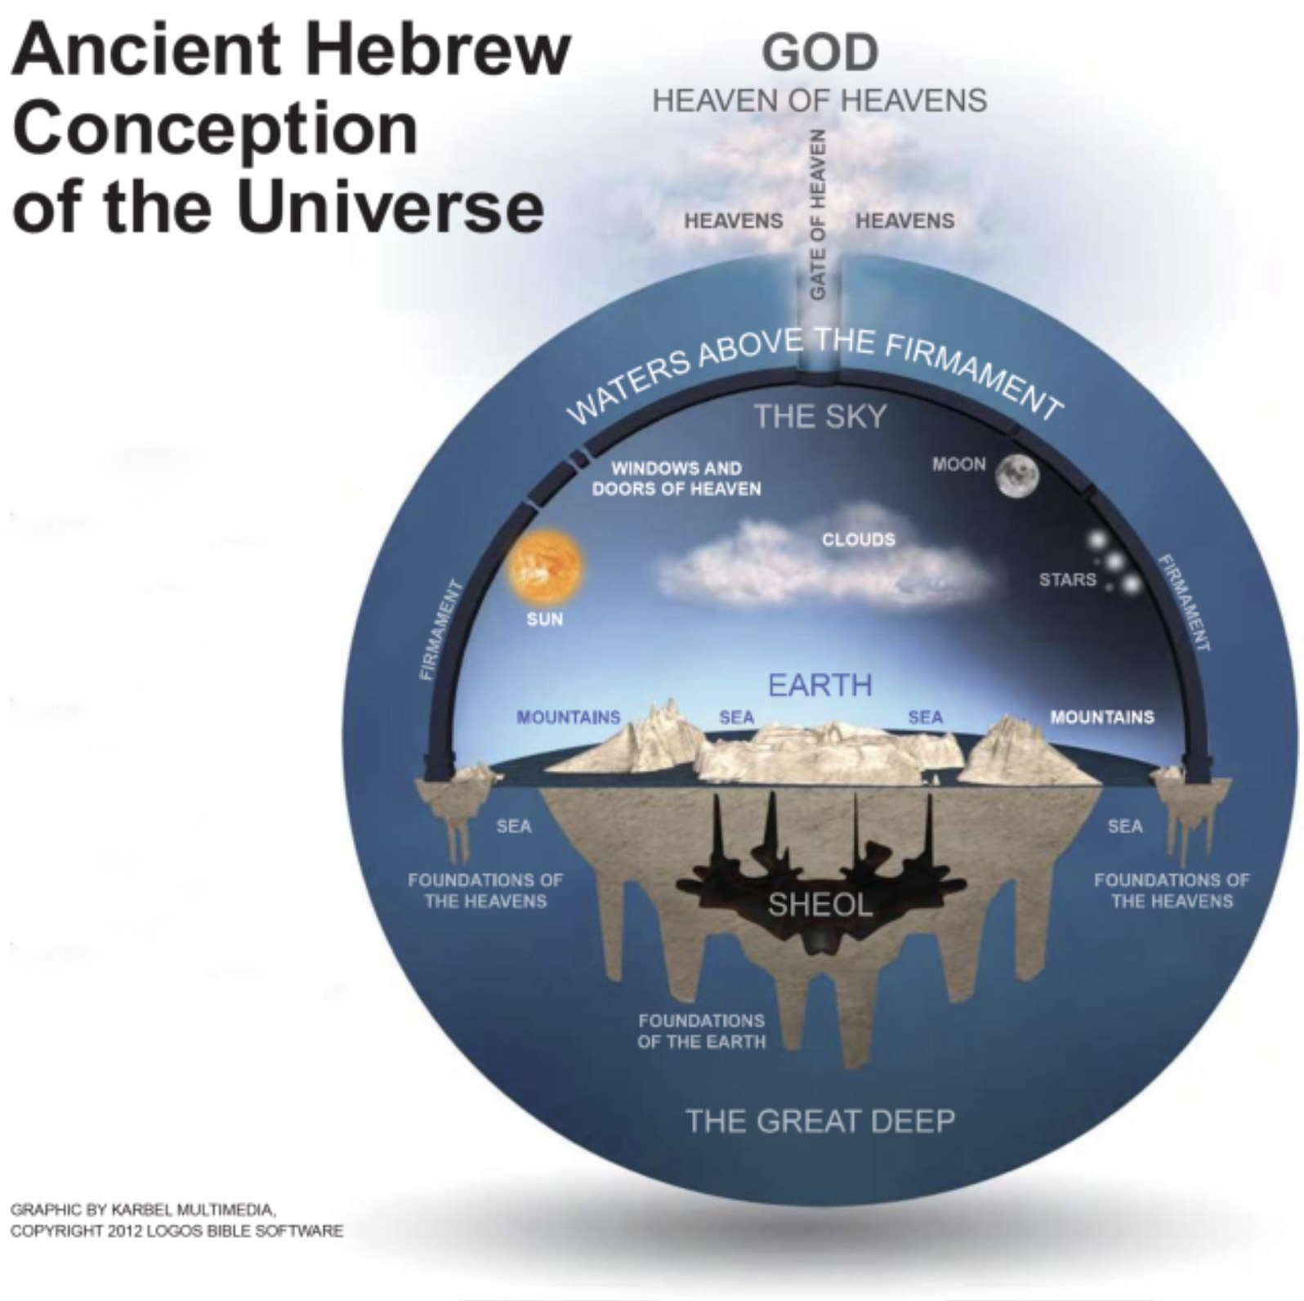

Slide 12
Old Testament Concept
Going to heaven presumptuous (i.e. Babel – Genesis 11:4)
No word for universe
Used the term “heaven” interchangeably with the name for God (Daniel 4:23)
King David given great insight into post-death condition

Slide 13
But God will redeem my soul from the power of Sheol, For He will receive me.
- Psalm 49:15

Slide 14
New Testament Concept of Heaven
Greek word – Heaven = Lift or heave
272 x N.T. / 82 x Matthew
Heavens created / Heavens = God
Heaven not a physical place

Slide 15
New Testament Concept of Heaven
Only mention of one heaven
God is not alone in heaven
Bible = Heaven where God dwells = Heaven where man + God dwell = Jesus is the bridge

Slide 16
But the day of the Lord will come like a thief, in which the heavens will pass away with a roar and the elements will be destroyed with intense heat, and the earth and its works will be burned up. Since all these things are to be destroyed in this way, what sort of people ought you to be in holy conduct and godliness, looking for and hastening the coming of the day of God, because of which the heavens will be destroyed by burning, and the elements will melt with intense heat! But according to His promise we are looking for new heavens and a new earth, in which righteousness dwells.
- II Peter 3:10-13

Slide 17
Then I saw a new heaven and a new earth; for the first heaven and the first earth passed away, and there is no longer any sea. And I saw the holy city, new Jerusalem, coming down out of heaven from God, made ready as a bride adorned for her husband.
- Revelation 21:1-2

Slide 18
The dimension where God and the saints will dwell = The New Heaven and Earth

Slide 19
Premillennialism
Main doctrine of Evangelicals / Pentecostals
John Darby – 1830
Scofield Reference Bible
Tim LaHaye (“Left Behind” Books)
John MacArthur, Jerry Falwell, David Jeremiah

Slide 20
Peter said to them, “Repent, and each of you be baptized in the name of Jesus Christ for the forgiveness of your sins; and you will receive the gift of the Holy Spirit.
- Acts 2:38

Slide 21
¹³ But we do not want you to be uninformed, brethren, about those who are asleep, so that you will not grieve as do the rest who have no hope. ¹⁴ For if we believe that Jesus died and rose again, even so God will bring with Him those who have fallen asleep in Jesus.
- I Thessalonians 4:13-14

Slide 22
And inasmuch as it is appointed for men to die once and after this comes judgment,
- Hebrews 9:27

Slide 23
Then Samuel said to Saul, “Why have you disturbed me by bringing me up?” And Saul answered, “I am greatly distressed; for the Philistines are waging war against me, and God has departed from me and no longer answers me, either through prophets or by dreams; therefore I have called you, that you may make known to me what I should do.”
- I Samuel 28:15

Slide 24
¹⁶ For the Lord Himself will descend from heaven with a shout, with the voice of the archangel and with the trumpet of God, and the dead in Christ will rise first. ¹⁷ Then we who are alive and remain will be caught up together with them in the clouds to meet the Lord in the air, and so we shall always be with the Lord.
- I Thessalonians 4:16-17

Slide 25
SIMPLE BIBLICAL TIMELINE
Resurrection of faithful
Baptism
Death / Sleep
Faithfulness
Lostness
ETERNITY HEAVEN
End of the World BANG!

Slide 26
New Heaven / New Earth: Features
God and resurrected saints exist (I Thess. 4:17 = Rev. 21:1-2; 21-22)
No pain / sorrow / death
No evil
Beautiful

Slide 27
New Heaven / New Earth: Experience
Pure Spirit
Stable
No Temptation
Complete Knowledge / Wisdom
No Time Pressure
Complete Righteousness
No Past

Slide 28
What Will We Do in Heaven?
Experience God
John 17:3

Slide 29
What Will We Do in Heaven?
Experience God – John 17:3
Judge nations and angels
I Cor. 6:2-3

Slide 30
What Will We Do in Heaven?
Experience God – John 17:3
Judge nations and angels – I Cor. 6:2-3
Serve and reign with God
II Timothy 2:12
Revelation 22:5

Slide 31
What Will We Do in Heaven?
Experience God – John 17:3
Judge nations and angels – I Cor. 6:2-3
Serve and reign with God
Continually praise God
And I heard a voice from heaven, like the sound of many waters and like the sound of loud thunder, and the voice which I heard was like the sound of harpists playing on their harps. - Revelation 14:2

Slide 32
What heaven are you striving for?

Slide 33
ONLY TWO OPTIONS
HELL HEAVEN
OR

