Slide 1
1
Introduction: The Golden Thread

Slide 3
Exodus is the true beginning of the story of Israel. Genesis is essential to the story, but it is a prologue, describing the lives of individual patriarchs rather than the history of a people. With Exodus we begin the story of the national entity called Israel. - D.A. Garrett, P. 15

Slide 4
Genesis
How the world came into being
Details of man’s creation and fall
Promise to Abraham
Family of Jacob

Slide 5
CREATION
JOSEPH
2200 YEARS

Slide 6
CREATION
REVELATION

Slide 7
Exodus
Jehovah – “I Am”
Plagues
Jewish Religion
Tabernacle / Priests / Sacrificial System

Slide 8
PENTATEUCH Penta = Five Teuchos = Scroll
{
Genesis Exodus Leviticus Numbers Deuteronomy

Slide 9
Author
{
Familiar with events
Access to particular information
Witness to miracles
MOSES

Slide 10
For if you believed Moses, you would believe Me, for he wrote about Me. But if you do not believe his writings, how will you believe My words?”
“Did not Moses give you the Law, and yet none of you carries out the Law? Why do you seek to kill Me?”
- John 5:46-47
- John 7:19

Slide 11
Date
Moses – 1445-1400 B.C.

Slide 12
EGYPT = Original name of the city of Memphis which referred to the “Mansion of the Spirit of PTAM"

Slide 13
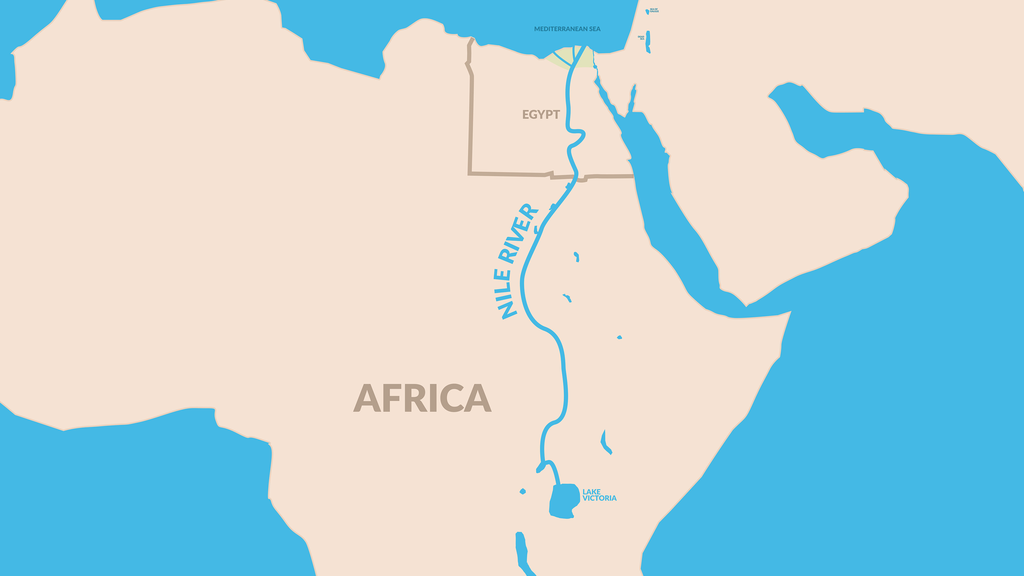
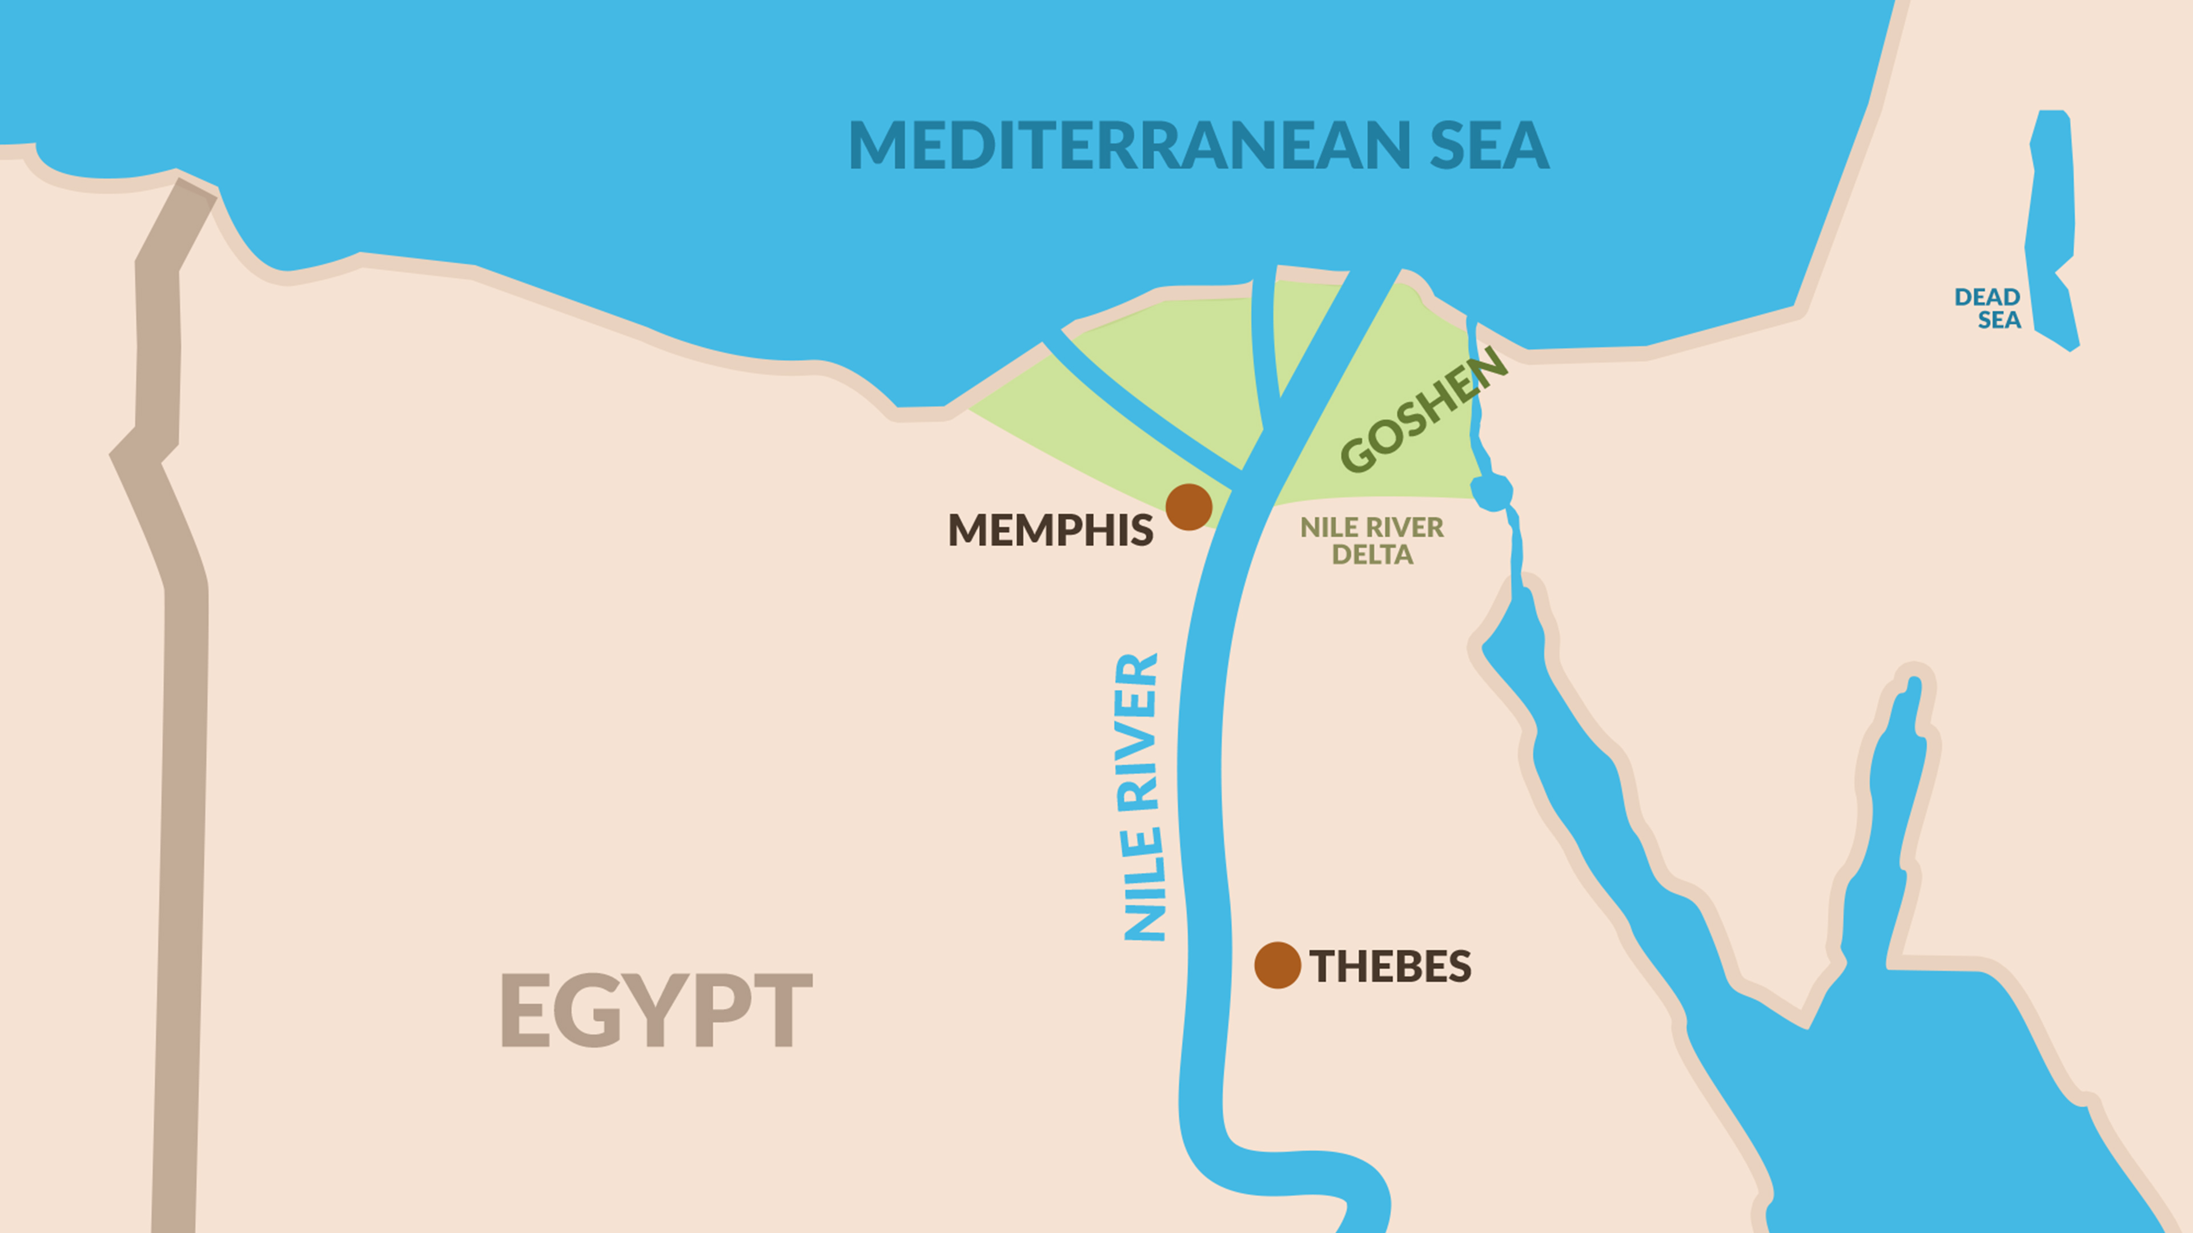
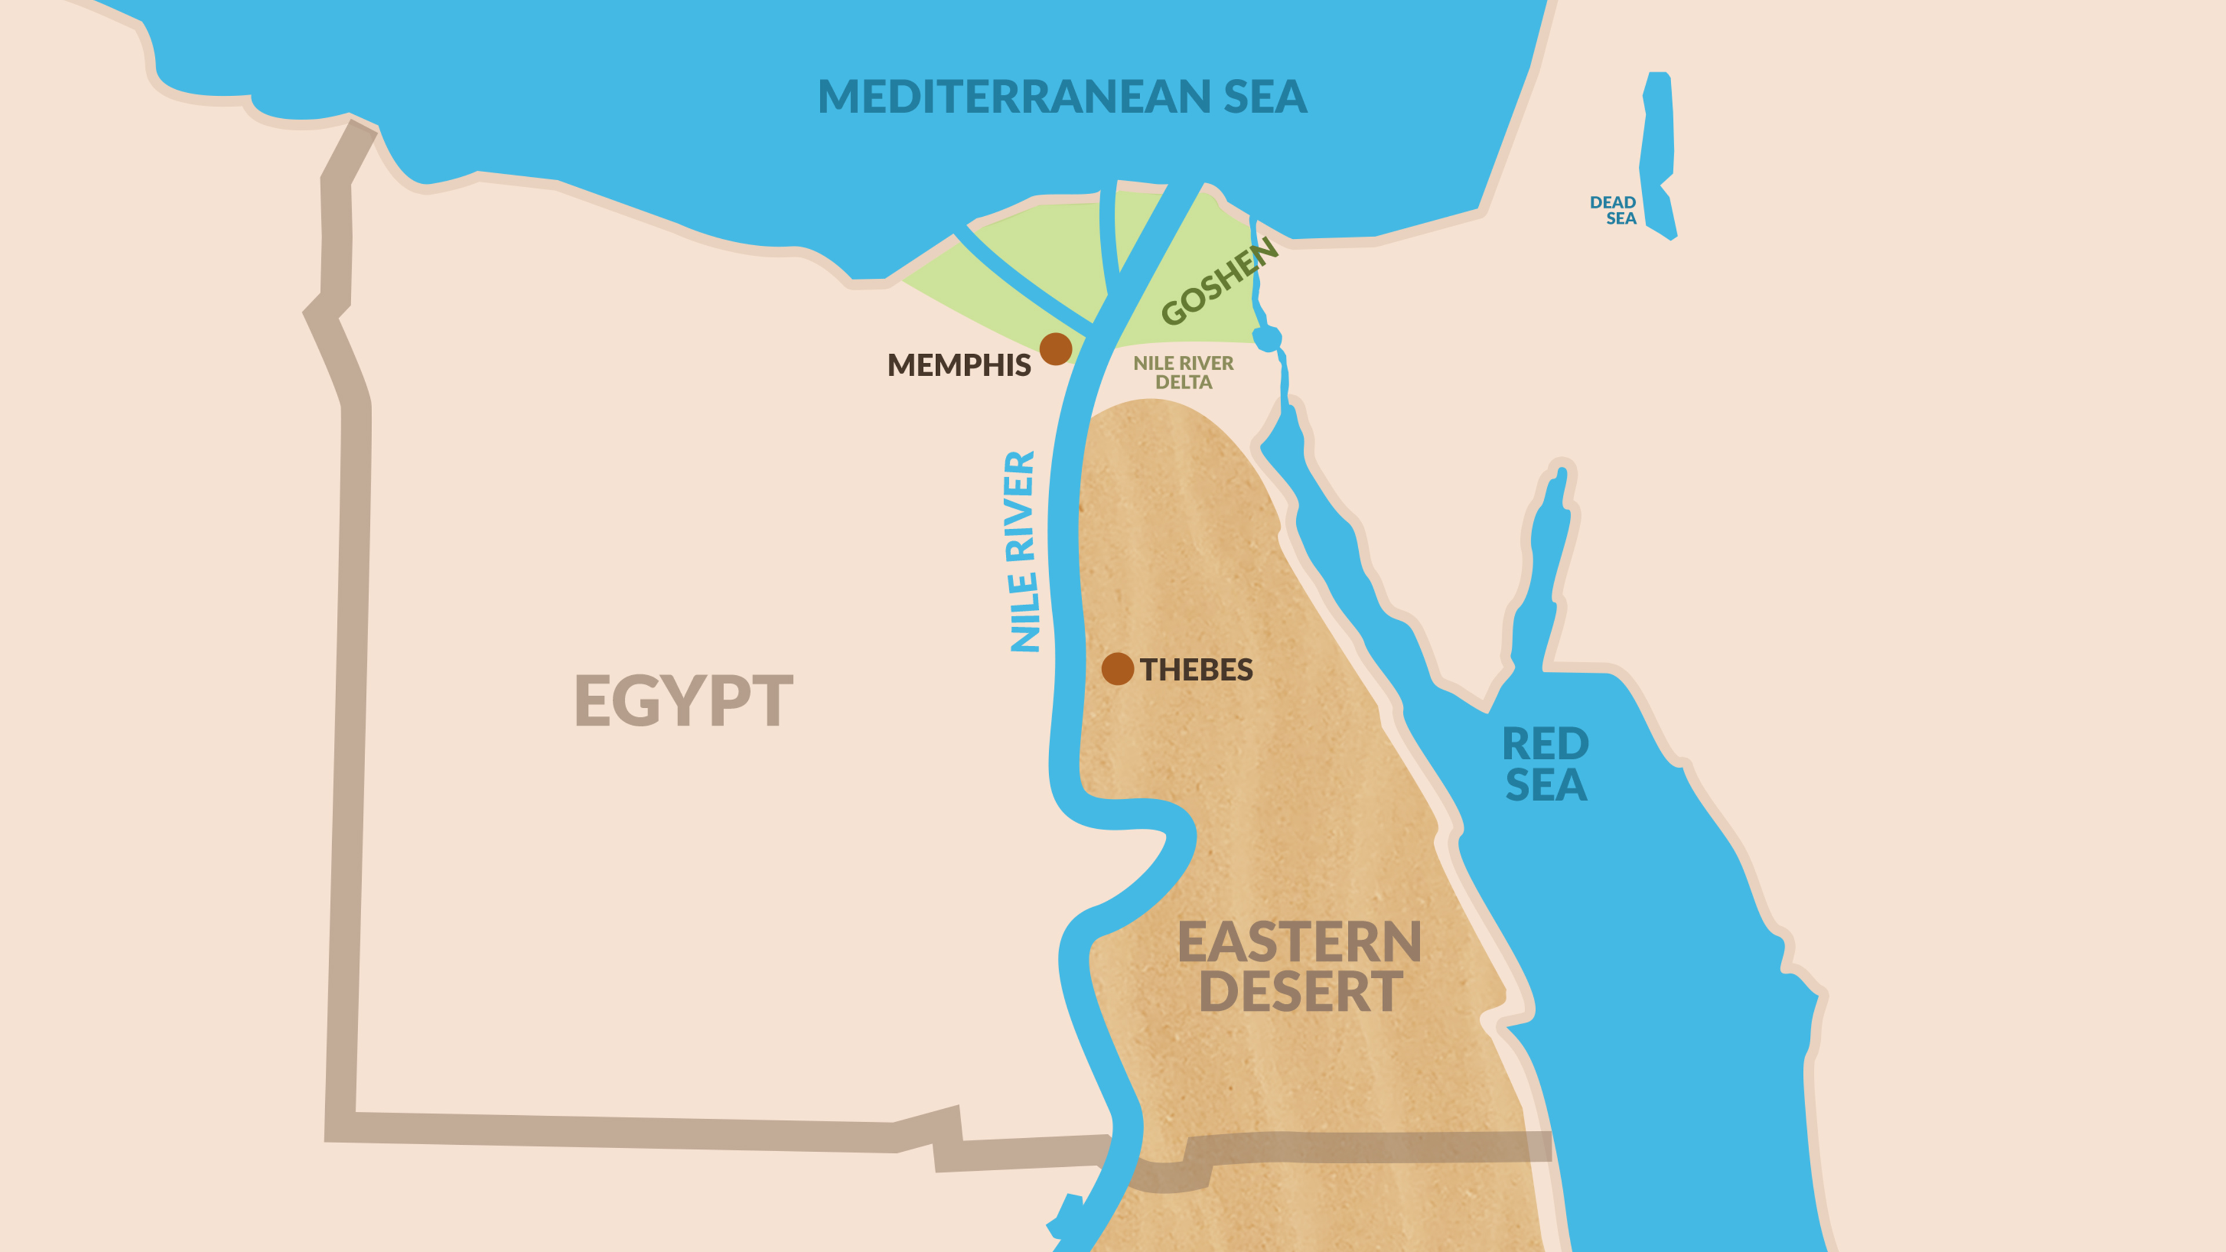
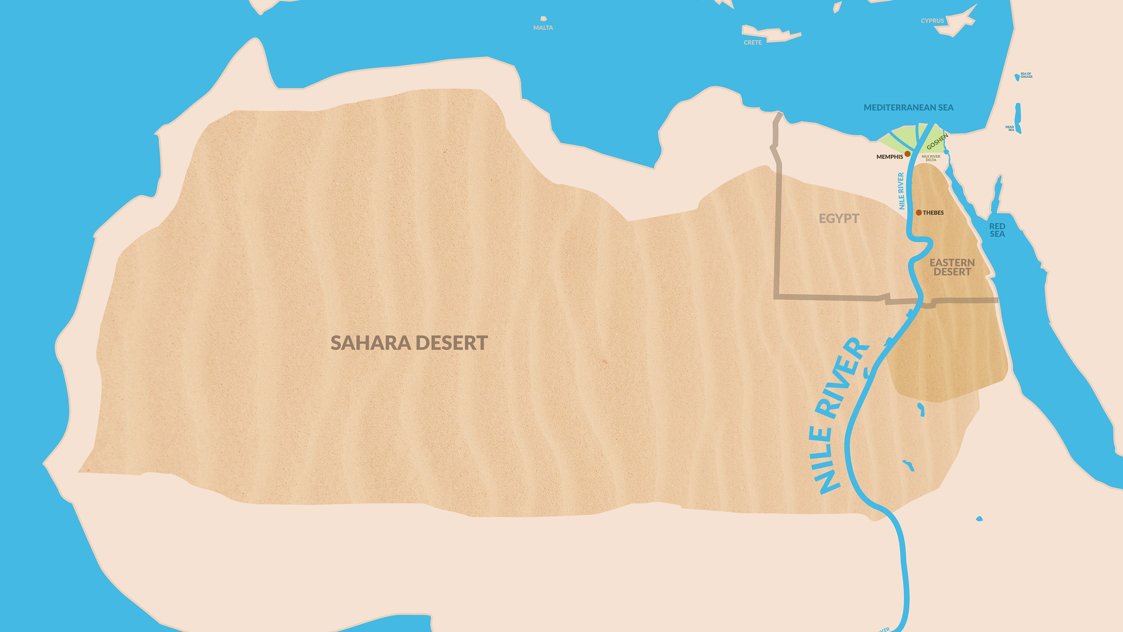
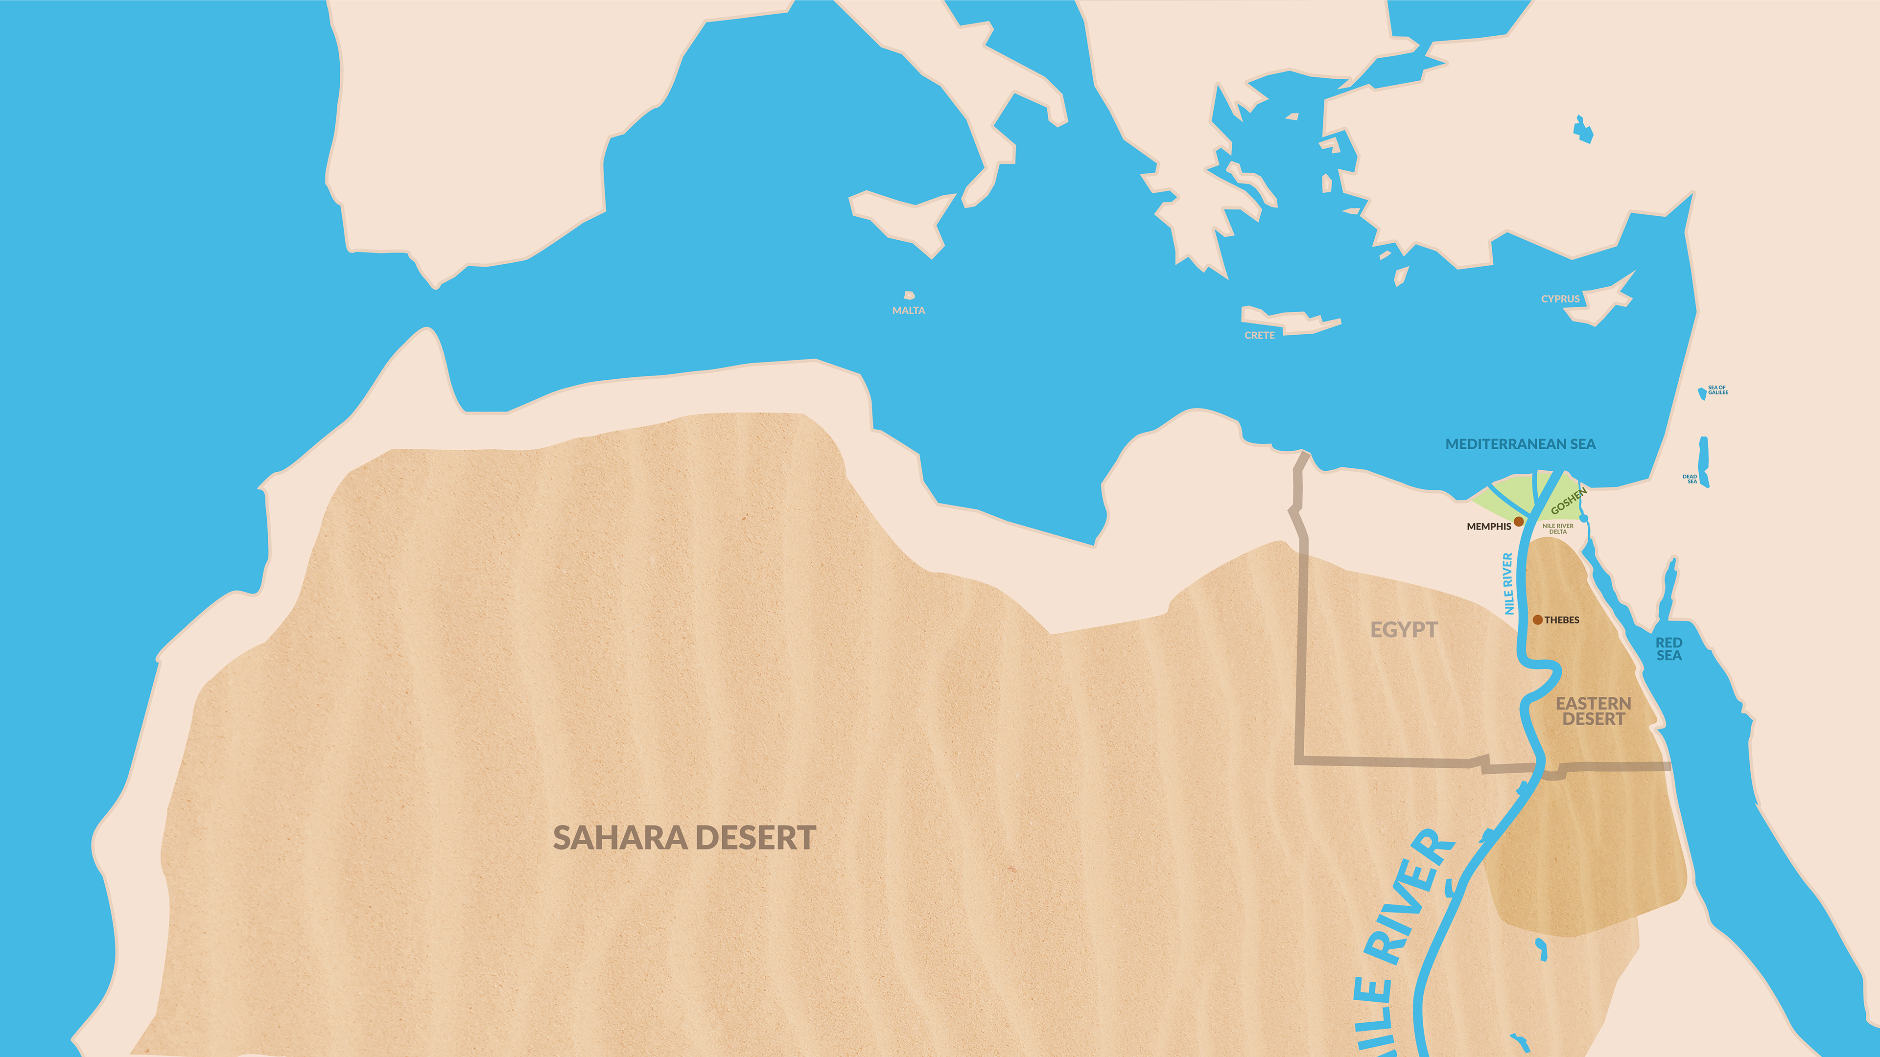
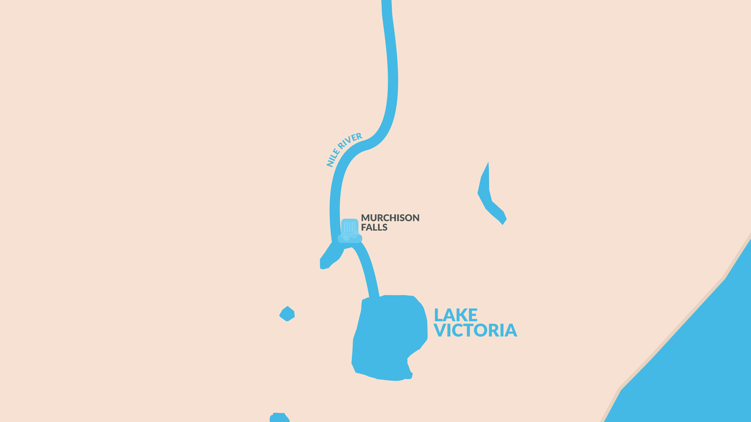
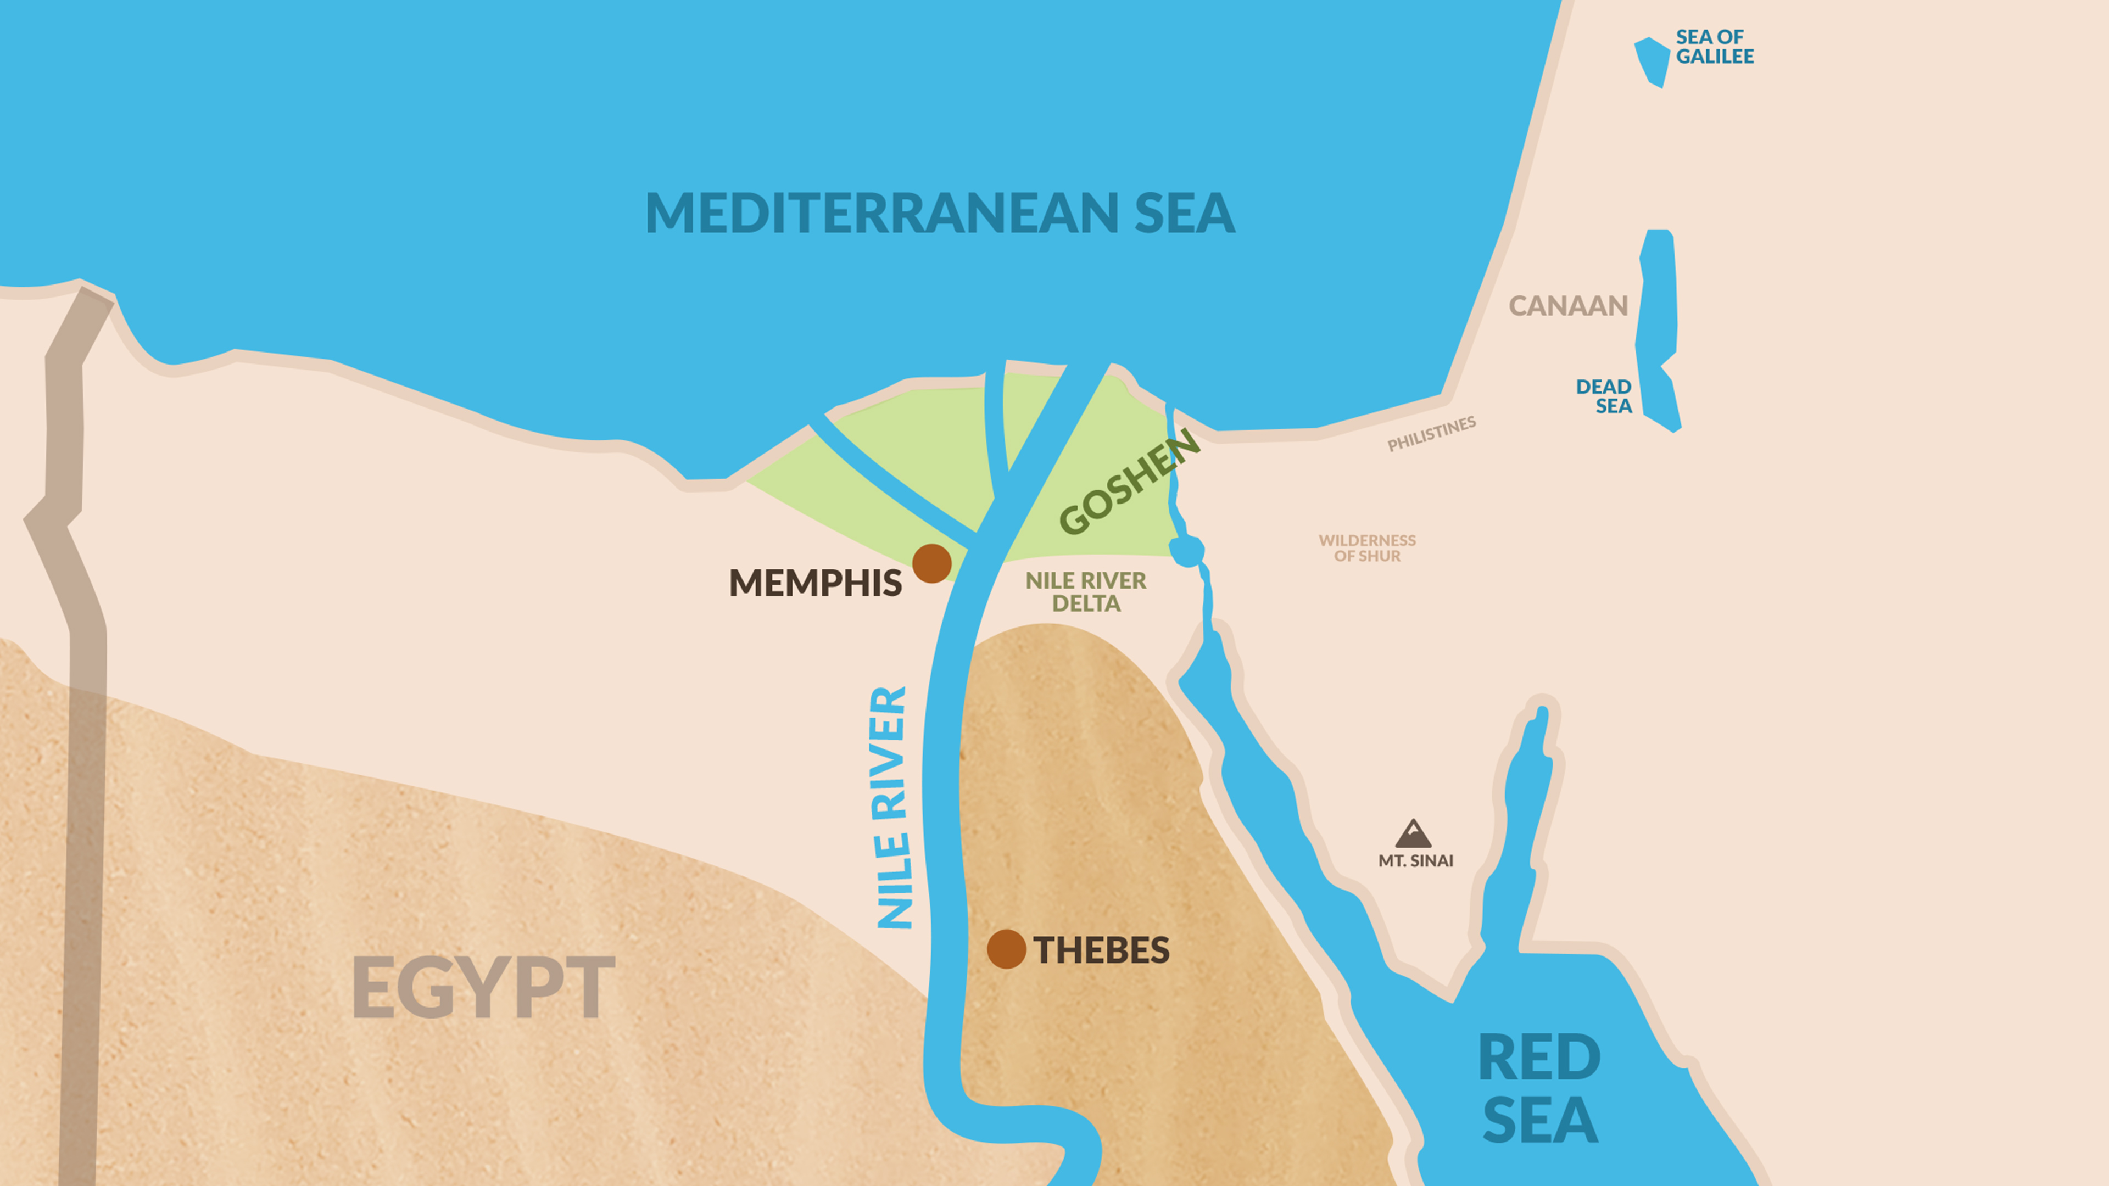

Slide 15
Chronology of Ancient Egypt
A. Kitchen, Egypt, A History of Chronology, Freedman, ABD Vol. 2
Major Eras | Dynasties | Dates | Remarks
Predynastic | n/a | Prior to 3000 | Egypt not unified
Archaic | “0” and 1st-2nd | 3000-2700 | Egypt unified and classical Egyptian culture established
Old Kingdom | 3rd-8th | 2700-2160 | Pyramid age; Egypt powerful and united
First Intermediate | 9th-10th | 2160-2010 | Political chaos; Egypt not united
Middle Kingdom | 11th-12th | 2106-1786 | A second era of power and unity; overlaps with the First Intermediate
Joseph

Slide 16
Chronology of Ancient Egypt
A. Kitchen, Egypt, A History of Chronology, Freedman, ABD Vol. 2
Major Eras | Dynasties | Dates | Remarks
Second Intermediate | 13th-17th | 1786-1550 | Weakness and division; this period includes the Hyksos dynasties (15th and 16th)
New Kingdom | 18th-20th | 1550-1069 | Egypt’s imperial age; the exodus probably took place in the 18th or 19th dynasty
Third Intermediate | 21st-25th | 1069-656 | Approximately coincides with Israelite monarchies; Egyptian power waxed and waned
Saite-Persian | 26th-31st | 654-332 | Foreign domination of Egypt
Ptolemaic | 32nd-33rd | 332-30 B.C. | Greek domination after Alexander the Great and subsequent rule by Ptolemaic kings
Roman | n/a | After 30 B.C. | Decline and end of classical Egyptian culture under Roman domination
Exodus

Slide 17
Exodus – Summary / Purpose
Historical Record – Egypt – Canaan

Slide 18
Exodus – Summary / Purpose
Historical Record – Egypt – Canaan
Transformation from clan to nation

Slide 19
Exodus – Summary / Purpose
Historical Record – Egypt – Canaan
Transformation from clan to nation
Jewish religion and practice

Slide 20
Exodus – Summary / Purpose
Historical Record – Egypt – Canaan
Transformation from clan to nation
Jewish religion and practice
How the Jews became the chosen people of God

Slide 21
Main Characters
The Jewish People

Slide 22
Main Characters
The Jewish People
God / YHWH
The one and universal God
God of Wrath
God of Mercy

Slide 23
Main Characters
The Jewish People
God / YHWH
The God who is wholly other
The God of Israel
The God of the Moral Law

Slide 24
Main Characters
The Jewish People
God / YHWH
Moses
The Man of God
The Founder of the Nation of Israel
Role model for those who aspire to spiritual leadership

Slide 25
Main Characters
Egypt
The symbol of worldly power
Who worship gods of wood and stone
Concentrate power
Oppress the righteous
Fixate on material prosperity
Oppose the Kingdom of God
Facilitate apostacy

Slide 26
Exodus reveals the features of the King of the heavenly Kingdom.

Slide 28
Exodus is the story of the formation of an early stage of this Kingdom (Nation of Israel) and the defeat of one of the first of these earthly kingdoms (Egypt).

Slide 29
Outline Read Chapters 1-10

