Slide 1
Giving our Best to God

Slide 2
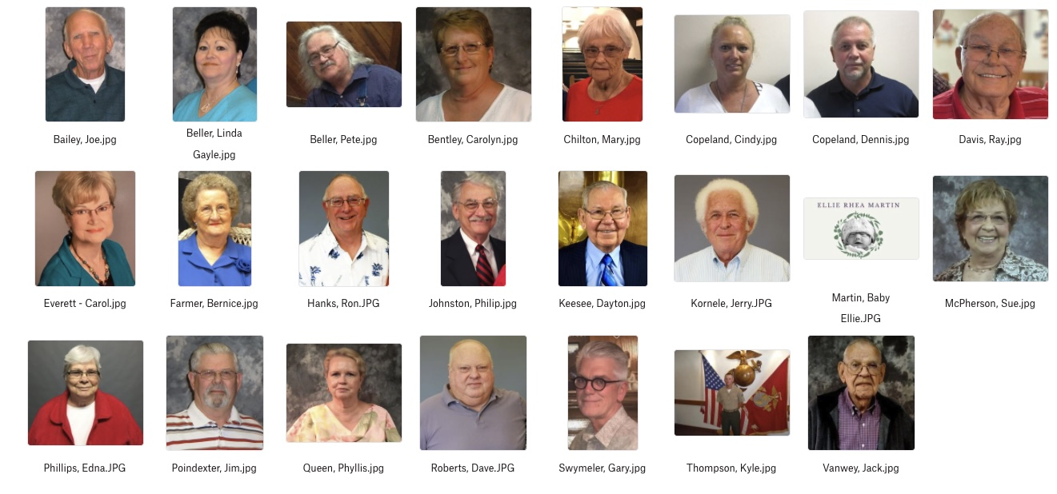
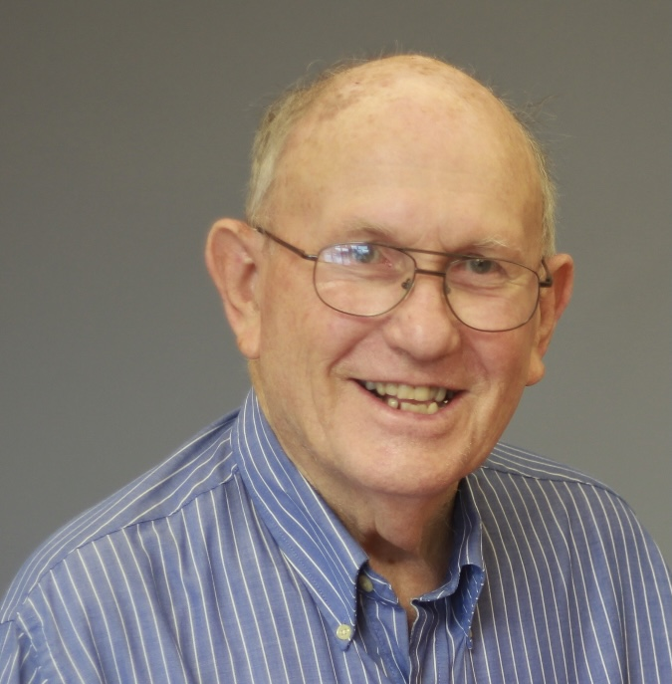

Slide 3
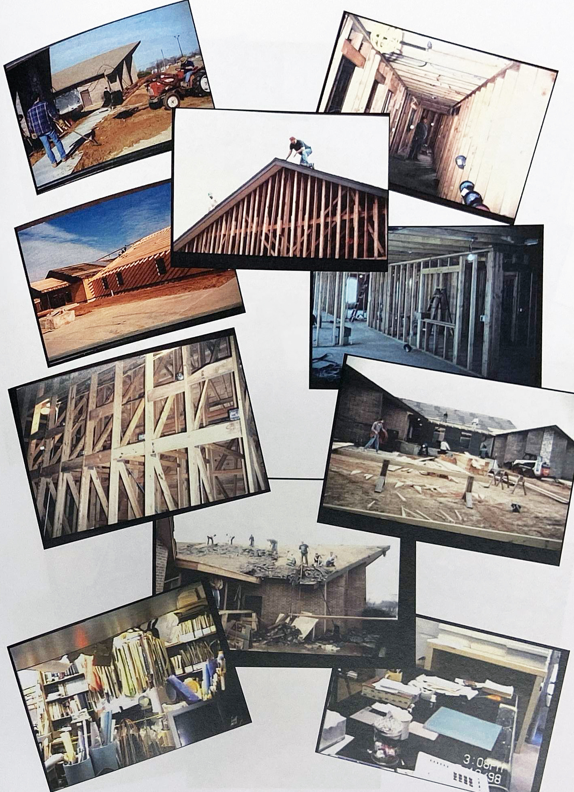

Slide 4
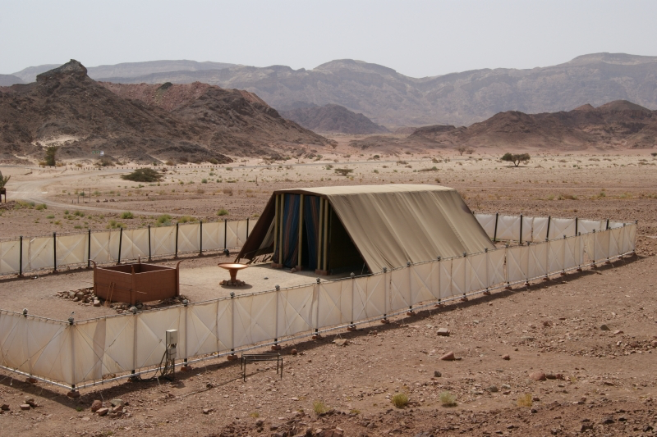
Model of the tabernacle in Timna Valley Park, Israel

Slide 5
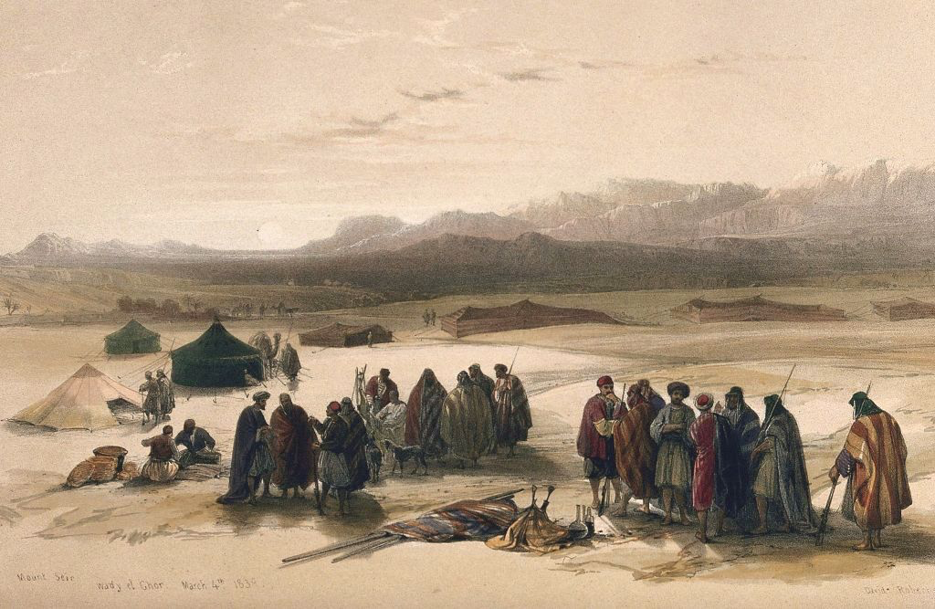
TheTorah.com

Slide 6
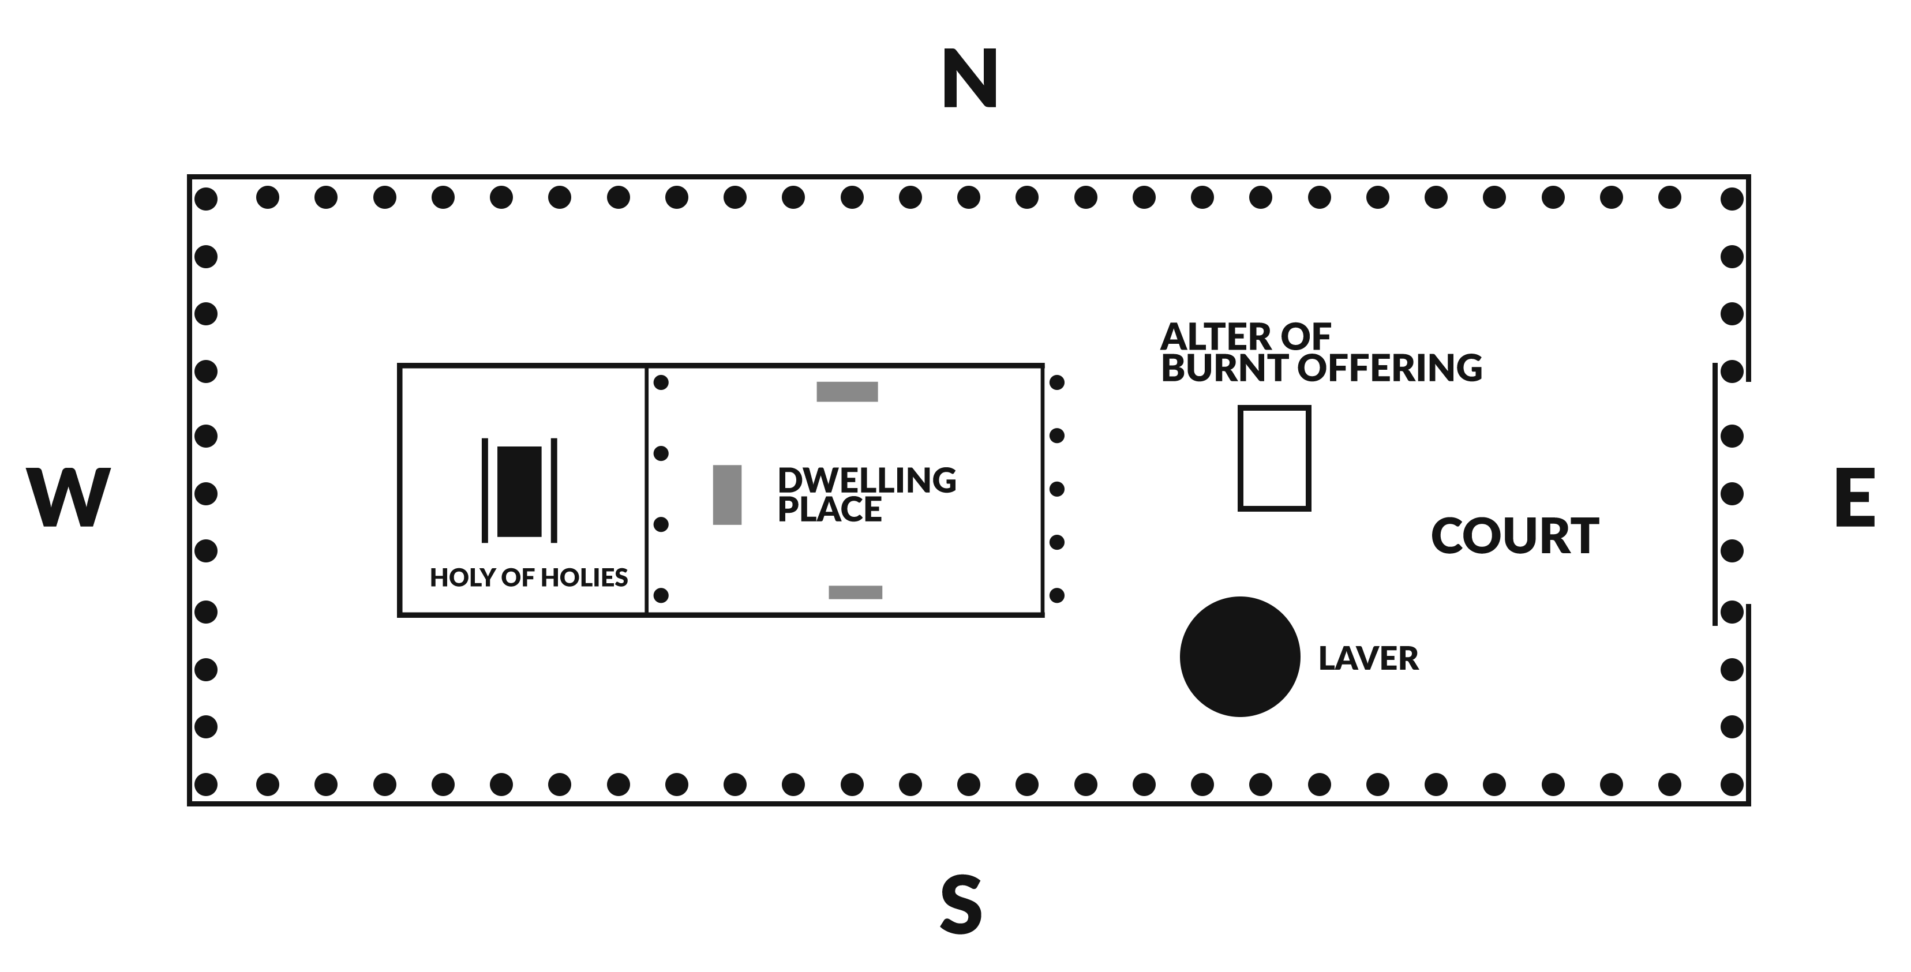

Slide 7
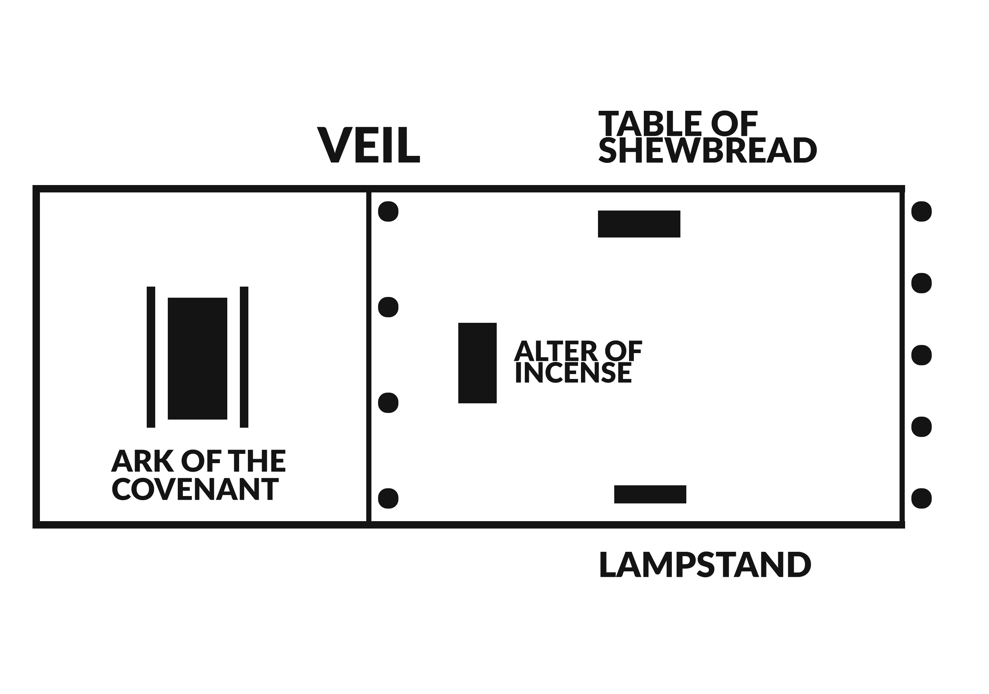

Slide 8
²⁰ Then all the congregation of the sons of Israel departed from Moses’ presence. ²¹ Everyone whose heart stirred him and everyone whose spirit moved him came and brought the Lord’s contribution for the work of the tent of meeting and for all its service and for the holy garments.
- Exodus 35:20-21

Slide 9
³⁰ Then Moses said to the sons of Israel, “See, the Lord has called by name Bezalel the son of Uri, the son of Hur, of the tribe of Judah. ³¹ And He has filled him with the Spirit of God, in wisdom, in understanding and in knowledge and in all craftsmanship; ³² to make designs for working in gold and in silver and in bronze, ³³ and in the cutting of stones for settings and in the carving of wood, so as to perform in every inventive work.
- Exodus 35:30-33

Slide 10
⁴ And all the skillful men who were performing all the work of the sanctuary came, each from the work which he was performing, ⁵ and they said to Moses, “The people are bringing much more than enough for the construction work which the Lord commanded us to perform.”
- Exodus 36:4-5

Slide 11
⁶ So Moses issued a command, and a proclamation was circulated throughout the camp, saying, “Let no man or woman any longer perform work for the contributions of the sanctuary.” Thus the people were restrained from bringing any more. ⁷ For the material they had was sufficient and more than enough for all the work, to perform it.
- Exodus 36:6-7

Slide 12
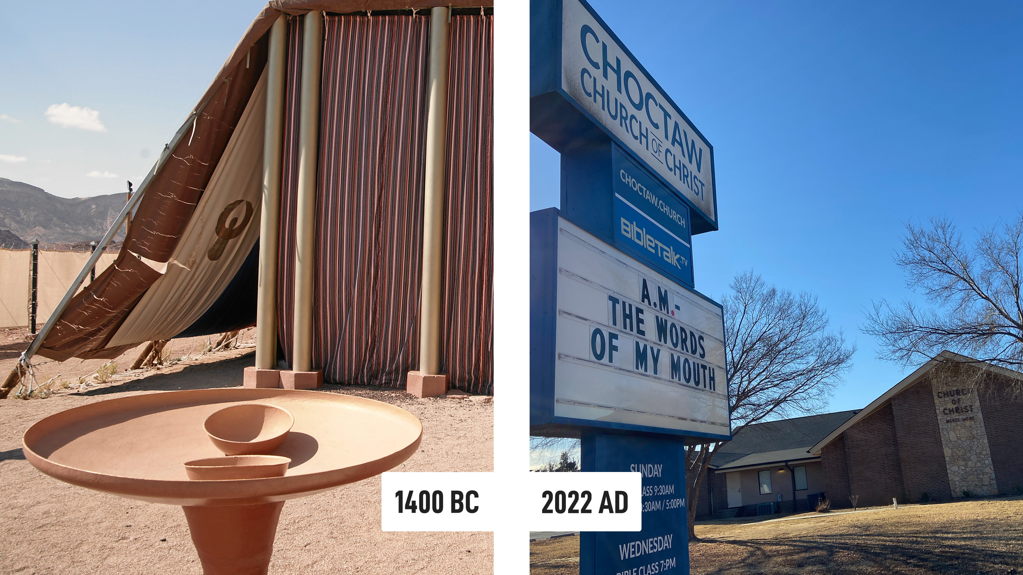

Slide 13
Building Lessons
Lesson #1 – God wants everyone to participate

Slide 14
Building Lessons
Lesson #1 – God wants everyone to participate
Lesson #2 – God wants your best

Slide 15
Building Lessons
Lesson #1 – God wants everyone to participate
Lesson #2 – God wants your best
Lesson #3 – One project prepares us for the next

Slide 16
Increased responsibility is a reward from God, not a burden!

Slide 17
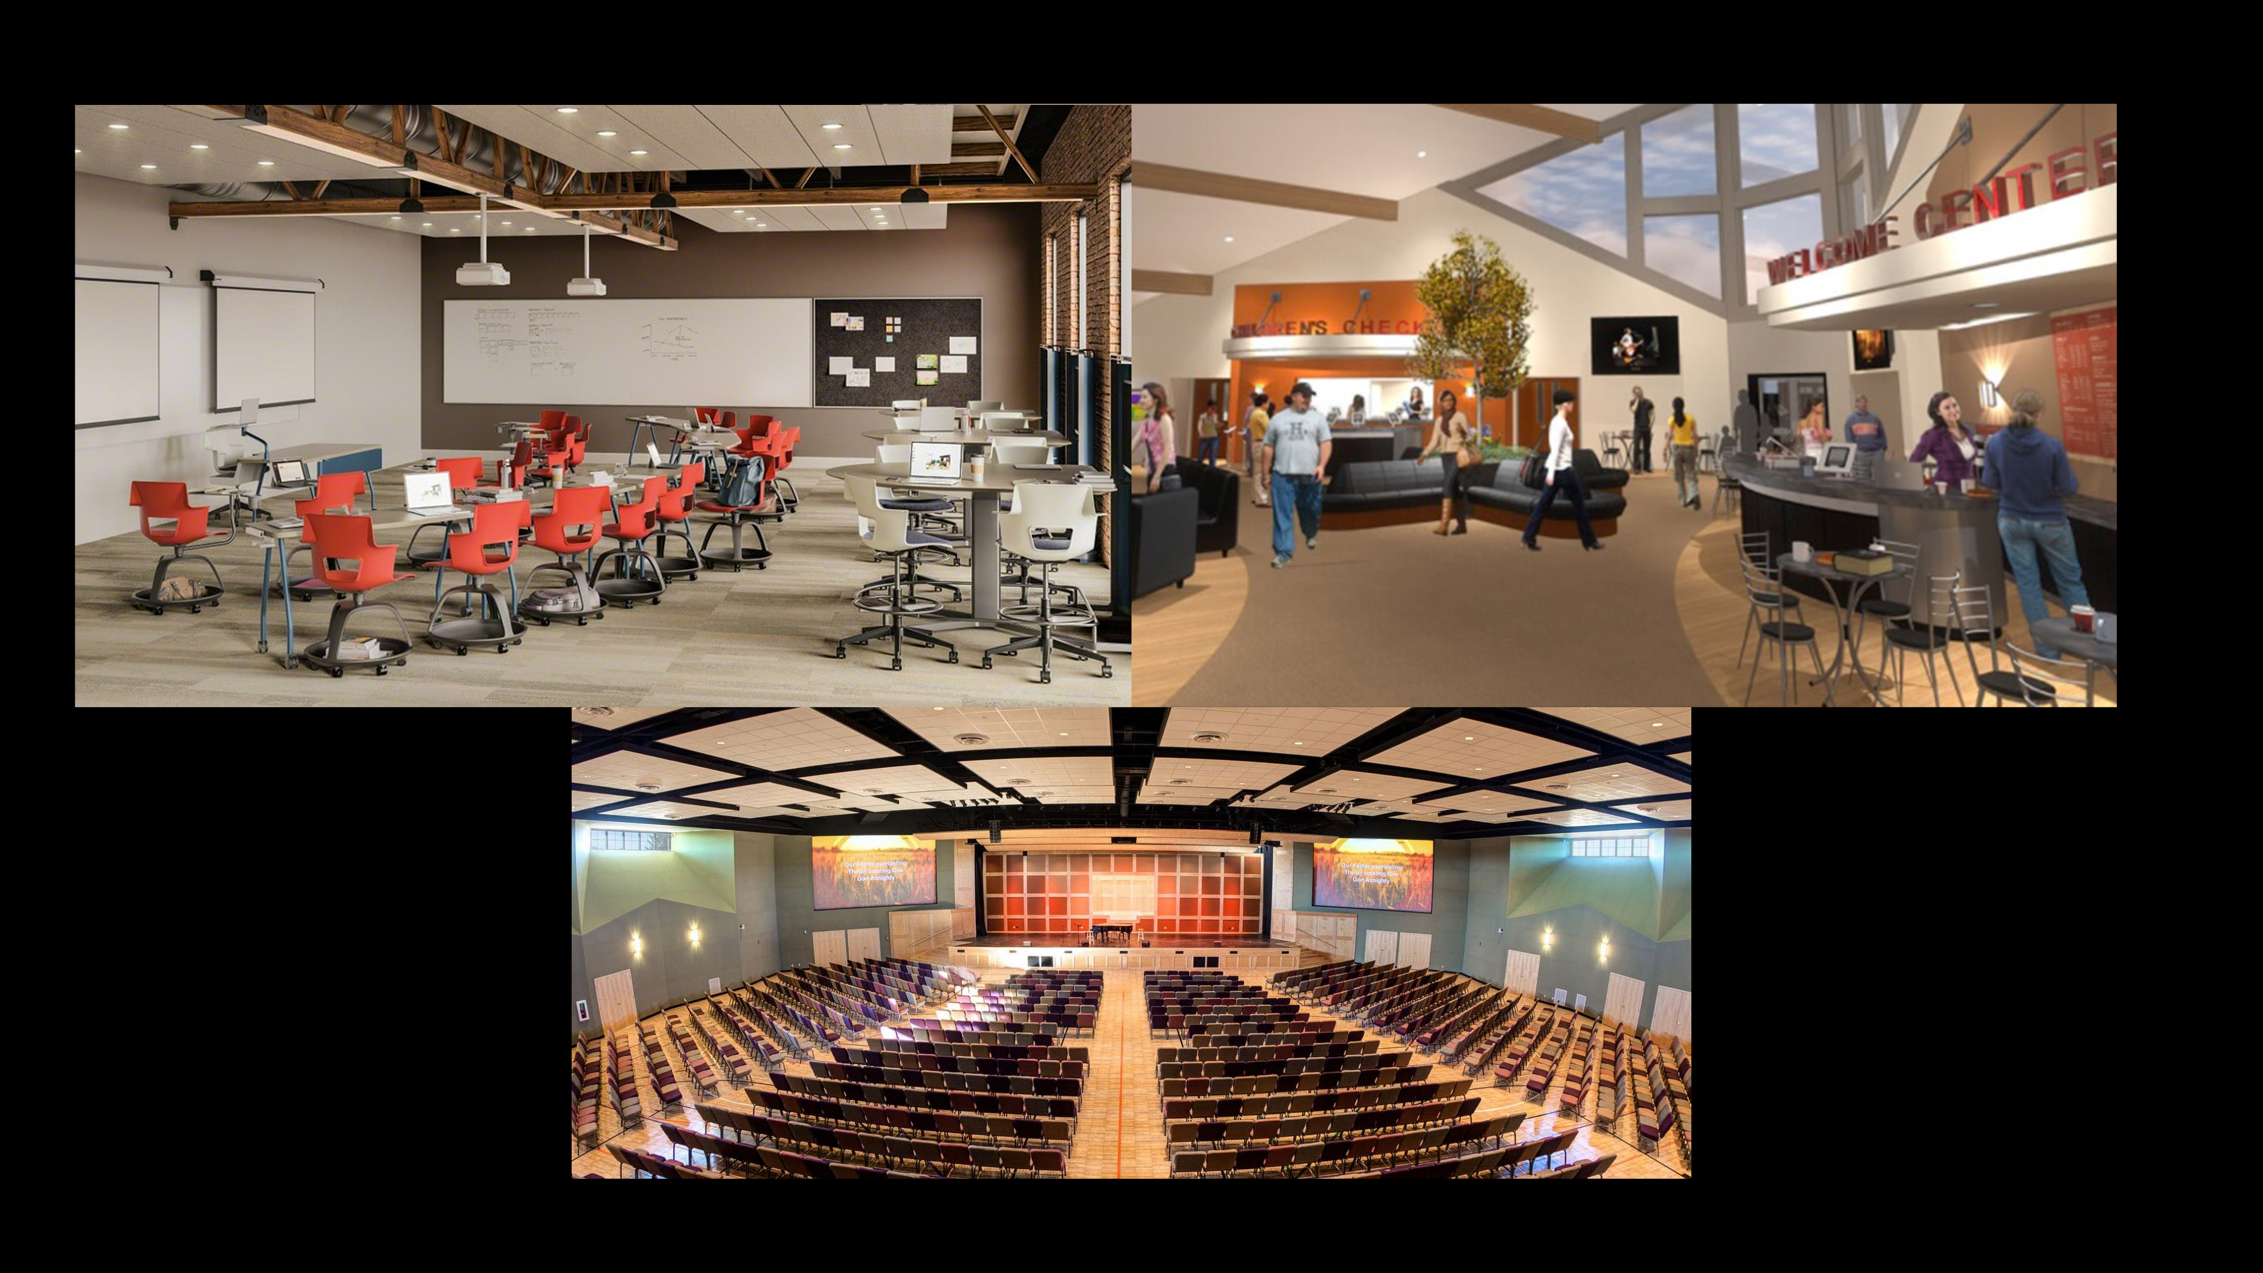

Slide 18
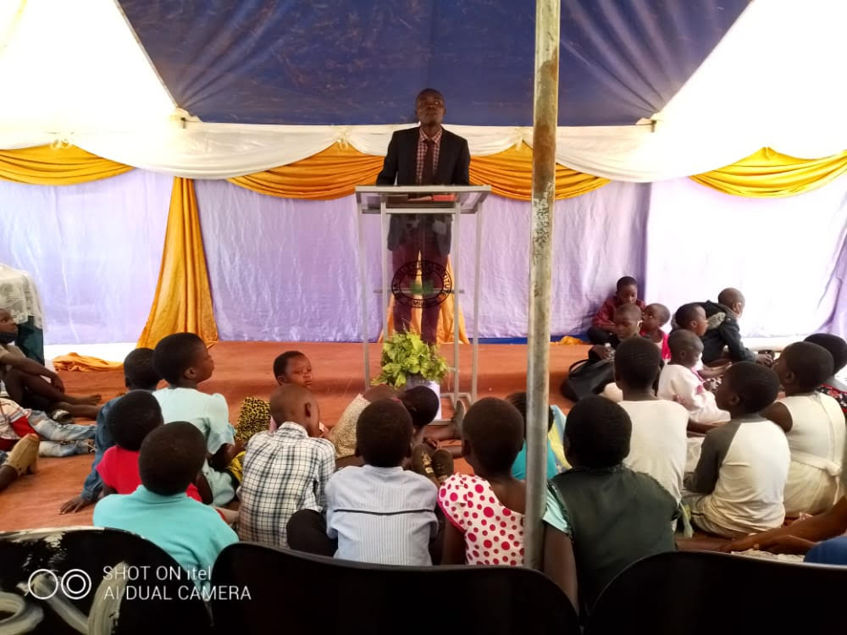
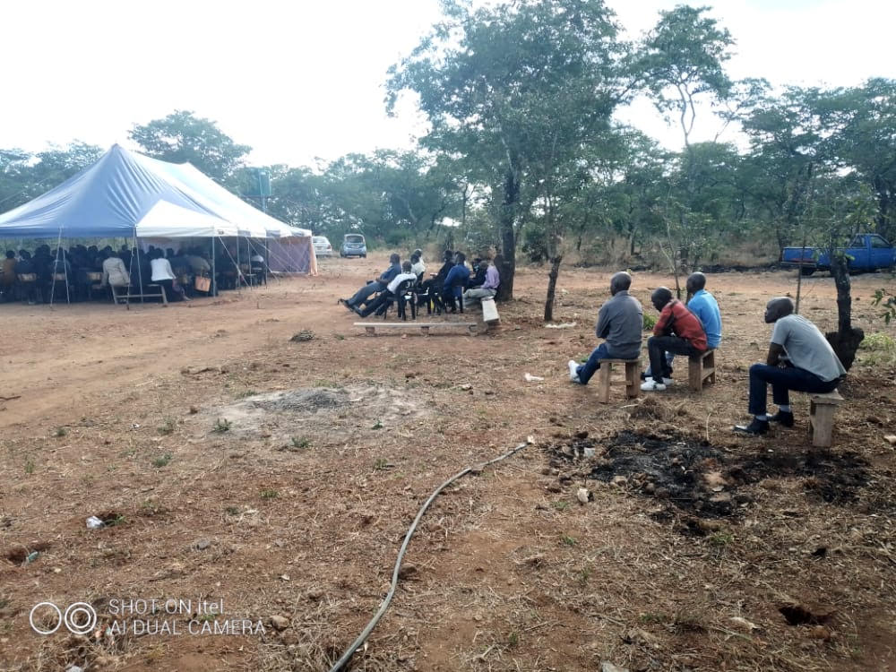

Slide 19
If we attempt to do such things, remember:
God will expect everyone to participate
God will expect our best
God will prepare us for the future

Slide 20
Building Lessons
Lesson #1 – God wants everyone to participate
Lesson #2 – God wants your best
Lesson #3 – One project prepares us for the next
Lesson #4 – God will always provide what we need

Slide 21
Is this a “first step” day?

