Slide 1
Enemies of the Cross

Slide 2
He who has believed and has been baptized shall be saved; but he who has disbelieved shall be condemned.
- Mark 16:16

Slide 3
BELIEVE
BAPTISM
SALVATION
=

Slide 4
BELIEVE
BAPTISM
SALVATION
PEACE
=

Slide 5
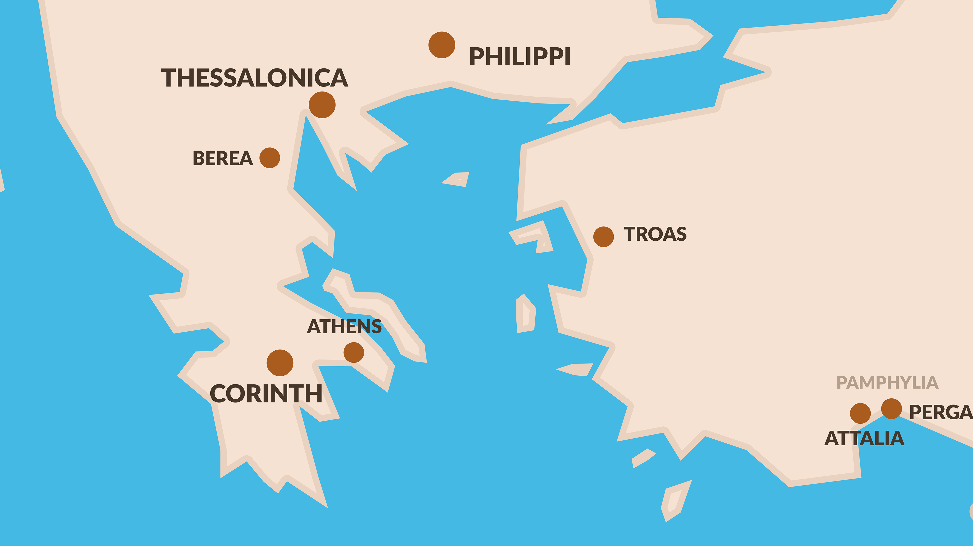

Slide 6
Philippi - Themes
Power of the Gospel of Jesus Christ

Slide 7
Philippi - Themes
Power of the Gospel of Jesus Christ
Joy
The Philippians
The Gospel Preached
Growth in Christ

Slide 8
ENEMIES OF THE CROSS
Finally, my brethren, rejoice in the Lord. To write the same things again is no trouble to me, and it is a safeguard for you.
- Philippians 3:1

Slide 9
Beware of the dogs, beware of the evil workers, beware of the false circumcision;
- Philippians 3:2

Slide 10
Enemies Described
Dogs
Evil Workers
False Circumcision (Judaizers)

Slide 11
CROSS
LIFE
LAW
LIFE
→

Slide 12
for we are the true circumcision, who worship in the Spirit of God and glory in Christ Jesus and put no confidence in the flesh,
- Philippians 3:3

Slide 13
SALVATION
FAITH
SALVATION
LAW

Slide 14
PAUL JUDAIZERS
vs.

Slide 15
^{PAUL vs. JUDAIZERS}
⁴ although I myself might have confidence even in the flesh. If anyone else has a mind to put confidence in the flesh, I far more: ⁵ circumcised the eighth day, of the nation of Israel, of the tribe of Benjamin, a Hebrew of Hebrews; as to the Law, a Pharisee;
- Philippians 3:4-5

Slide 16
⁶ as to zeal, a persecutor of the church; as to the righteousness which is in the Law, found blameless. ⁷ But whatever things were gain to me, those things I have counted as loss for the sake of Christ.
- Philippians 3:6-7

Slide 17
FAITH LAW
vs.

Slide 18
^{FAITH vs. LAW}
More than that, I count all things to be loss in view of the surpassing value of knowing Christ Jesus my Lord, for whom I have suffered the loss of all things, and count them but rubbish so that I may gain Christ,
- Philippians 3:8

Slide 19
and may be found in Him, not having a righteousness of my own derived from the Law, but that which is through faith in Christ, the righteousness which comes from God on the basis of faith,
- Philippians 3:9

Slide 20
¹⁰ that I may know Him and the power of His resurrection and the fellowship of His sufferings, being conformed to His death; ¹¹ in order that I may attain to the resurrection from the dead.
- Philippians 3:10-11

Slide 21
THE PRIZE = ETERNAL LIFE

Slide 22
^{THE PRIZE = ETERNAL LIFE}
¹² Not that I have already obtained it or have already become perfect, but I press on so that I may lay hold of that for which also I was laid hold of by Christ Jesus. ¹³ Brethren, I do not regard myself as having laid hold of it yet; but one thing I do: forgetting what lies behind and reaching forward to what lies ahead,
- Philippians 3:12-13

Slide 23
I press on toward the goal for the prize of the upward call of God in Christ Jesus.
- Philippians 3:14

Slide 24
^{PERFECTION}
¹⁵ Let us therefore, as many as are perfect, have this attitude; and if in anything you have a different attitude, God will reveal that also to you; ¹⁶ however, let us keep living by that same standard to which we have attained.
- Philippians 3:15-16

Slide 25
THE GOSPEL IS ALL WE NEED. (Romans 1:16)

Slide 26
CONDEMNATION OF THE ENEMIES

Slide 27
Brethren, join in following my example, and observe those who walk according to the pattern you have in us.
- Philippians 3:17

Slide 28
For many walk, of whom I often told you, and now tell you even weeping, that they are enemies of the cross of Christ,
- Philippians 3:18

Slide 29
whose end is destruction, whose god is their appetite, and whose glory is in their shame, who set their minds on earthly things.
- Philippians 3:19

Slide 30
Motives and Punishment
They will lose their salvation

Slide 31
Motives and Punishment
They will lose their salvation
Their Lord is not Jesus

Slide 32
Motives and Punishment
They will lose their salvation
Their Lord is not Jesus
They depend on the wrong thing

Slide 33
^{COMMENDATION OF THE FAITHFUL}
²⁰ For our citizenship is in heaven, from which also we eagerly wait for a Savior, the Lord Jesus Christ; ²¹ who will transform the body of our humble state into conformity with the body of His glory, by the exertion of the power that He has even to subject all things to Himself.
- Philippians 3:20-21

Slide 34
Jesus created our physical bodies – Gen. 1:26-27
earthly
Jesus will create our spiritual bodies – I Cor. 15:5-55
glorified

Slide 35
Therefore:
Be careful

Slide 36
Therefore:
Be careful
Be models

Slide 37
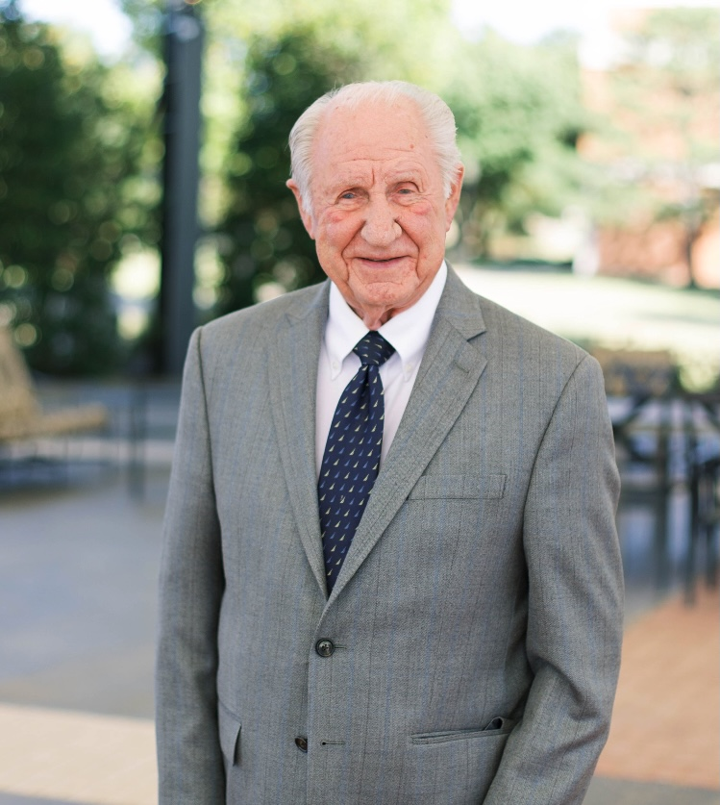
Therefore:
Be careful
Be models
Be there!

Slide 38
If Jesus came for you tonight… would you BE THERE?

