Slide 1
3
What Are the Different Levels of Faith?

Slide 2
Different Levels of Faith
Imitating Faith
“I don’t understand; I just do what you do.”

Slide 3
Different Levels of Faith
Imitating Faith
Affiliating Faith
"I understand, but I only believe because others do."

Slide 4
Different Levels of Faith
Imitating Faith
Affiliating Faith
Searching Faith
"I am checking this out for myself."

Slide 5
Different Levels of Faith
Imitating Faith
Affiliating Faith
Searching Faith
Solidifying Faith
"Let me piece this all together."

Slide 6
Different Levels of Faith
Imitating Faith
Affiliating Faith
Searching Faith
Solidifying Faith
Mature Faith
"Nothing will stop me from trusting in God."

Slide 7
Mature Faith Solidifying Faith Searching Faith Affiliating Faith Imitating Faith

Slide 8
Biblical Examples
Acts 8:9-20
Simon’s faith was based on what others were doing; he didn’t really understand.

Slide 9
⁹ Now there was a man named Simon, who formerly was practicing magic in the city and astonishing the people of Samaria, claiming to be someone great; ¹⁰ and they all, from smallest to greatest, were giving attention to him, saying, “This man is what is called the Great Power of God.”
- Acts 8:9-10

Slide 10
¹¹ And they were giving him attention because he had for a long time astonished them with his magic arts. ¹² But when they believed Philip preaching the good news about the kingdom of God and the name of Jesus Christ, they were being baptized, men and women alike.
- Acts 8:11-12

Slide 11
Even Simon himself believed; and after being baptized, he continued on with Philip, and as he observed signs and great miracles taking place, he was constantly amazed.
- Acts 8:13

Slide 12
¹⁴ Now when the apostles in Jerusalem heard that Samaria had received the word of God, they sent them Peter and John, ¹⁵ who came down and prayed for them that they might receive the Holy Spirit. ¹⁶ For He had not yet fallen upon any of them; they had simply been baptized in the name of the Lord Jesus.
- Acts 8:14-16

Slide 13
¹⁷ Then they began laying their hands on them, and they were receiving the Holy Spirit. ¹⁸ Now when Simon saw that the Spirit was bestowed through the laying on of the apostles’ hands, he offered them money,
- Acts 8:17-18

Slide 14
¹⁹ saying, “Give this authority to me as well, so that everyone on whom I lay my hands may receive the Holy Spirit.” ²⁰ But Peter said to him, “May your silver perish with you, because you thought you could obtain the gift of God with money!
- Acts 8:19-20

Slide 15
Biblical Examples
John 4:25-42
The town’s people had faith based on their affiliation with the Samaritan woman.

Slide 16
²⁵ The woman said to Him, “I know that Messiah is coming (He who is called Christ); when that One comes, He will declare all things to us.” ²⁶ Jesus said to her, “I who speak to you am He.”
- John 4:25-26

Slide 17
²⁷ At this point His disciples came, and they were amazed that He had been speaking with a woman, yet no one said, “What do You seek?” or, “Why do You speak with her?” ²⁸ So the woman left her waterpot, and went into the city and said to the men,
- John 4:27-28

Slide 18
²⁹ “Come, see a man who told me all the things that I have done; this is not the Christ, is it?” ³⁰ They went out of the city, and were coming to Him.
- John 4:29-30

Slide 19
³¹ Meanwhile the disciples were urging Him, saying, “Rabbi, eat.” ³² But He said to them, “I have food to eat that you do not know about.” ³³ So the disciples were saying to one another, “No one brought Him anything to eat, did he?”
- John 4:31-33

Slide 20
³⁴ Jesus said to them, “My food is to do the will of Him who sent Me and to accomplish His work. ³⁵ Do you not say, ‘There are yet four months, and then comes the harvest’? Behold, I say to you, lift up your eyes and look on the fields, that they are white for harvest.
- John 4:34-35

Slide 21
³⁶ Already he who reaps is receiving wages and is gathering fruit for life eternal; so that he who sows and he who reaps may rejoice together. ³⁷ For in this case the saying is true, ‘One sows and another reaps.’ ³⁸ I sent you to reap that for which you have not labored; others have labored and you have entered into their labor.”
- John 4:36-38

Slide 22
³⁹ From that city many of the Samaritans believed in Him because of the word of the woman who testified, “He told me all the things that I have done.” ⁴⁰ So when the Samaritans came to Jesus, they were asking Him to stay with them; and He stayed there two days.
- John 4:39-40

Slide 23
⁴¹ Many more believed because of His word; ⁴² and they were saying to the woman, “It is no longer because of what you said that we believe, for we have heard for ourselves and know that this One is indeed the Savior of the world.”
- John 4:41-42

Slide 24
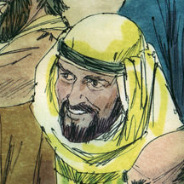
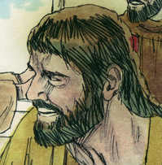
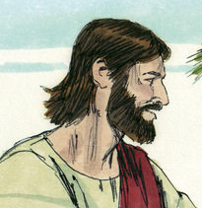
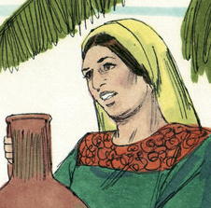
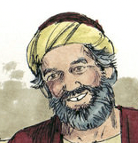
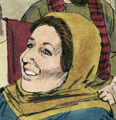
FAITH

Slide 25
FAITH

Slide 26
Affiliating faith is how most of us come to Christ, but it's not good to stay there.

Slide 27
If you believe what you believe because others believe it, you have Affiliating Faith.

Slide 28
Biblical Examples
Acts 17:10-12
The Bereans searched out their own faith. They examined even the teachings of Paul and Silas to be certain they were true.

Slide 29
¹⁰ The brethren immediately sent Paul and Silas away by night to Berea, and when they arrived, they went into the synagogue of the Jews. ¹¹ Now these were more noble-minded than those in Thessalonica, for they received the word with great eagerness, examining the Scriptures daily to see whether these things were so. ¹² Therefore many of them believed, along with a number of prominent Greek women and men.
- Acts 17:10-12

Slide 30
Biblical Examples
2 Timothy 1:5-7
Timothy did not quite have mature faith. He still needed to solidify the faith he had.

Slide 31
⁵ For I am mindful of the sincere faith within you, which first dwelt in your grandmother Lois and your mother Eunice, and I am sure that it is in you as well. ⁶ For this reason I remind you to kindle afresh the gift of God which is in you through the laying on of my hands. ⁷ For God has not given us a spirit of timidity, but of power and love and discipline.
- 2 Timothy 1:5-7

Slide 32
Biblical Examples
Acts 27:21-25
Paul developed his faith to the point where nothing could dissuade him from following God.

Slide 33
²¹ When they had gone a long time without food, then Paul stood up in their midst and said, “Men, you ought to have followed my advice and not to have set sail from Crete and incurred this damage and loss. ²² Yet now I urge you to keep up your courage, for there will be no loss of life among you, but only of the ship.
- Acts 27:21-22

Slide 34
²³ For this very night an angel of the God to whom I belong and whom I serve stood before me, ²⁴ saying, ‘Do not be afraid, Paul; you must stand before Caesar; and behold, God has granted you all those who are sailing with you.’
- Acts 27:23-24

Slide 35
Therefore, keep up your courage, men, for I believe God that it will turn out exactly as I have been told.
- Acts 27:25

