Slide 1
4 R's in Rehabilitation

Slide 2
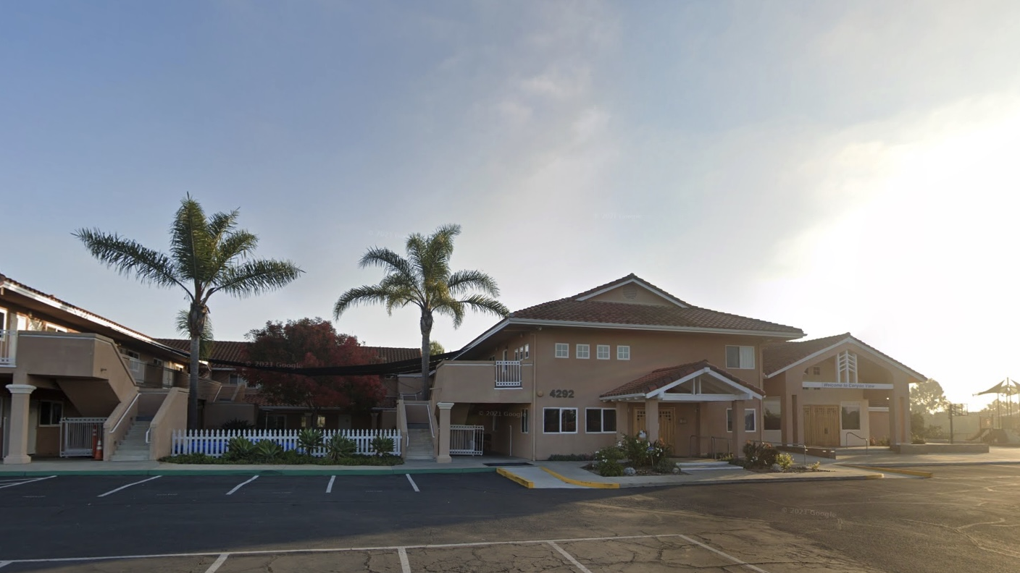
CANYON VIEW CHURCH OF CHRIST
SAN DIEGO, CALIFORNIA

Slide 3
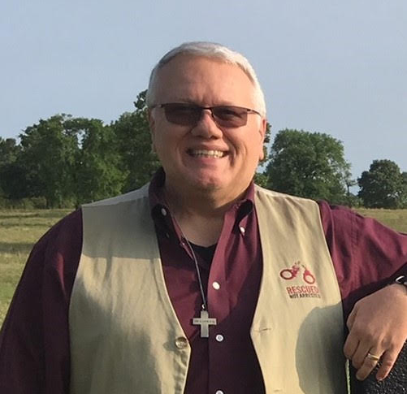
CARL ETCHISON
CV PRISON MINISTRY

Slide 4
No Rehab = No Restoration

Slide 5
David’s Sin and Rehabilitation I Chronicles 21:1-30

Slide 6
¹ Now after this it came about that David defeated the Philistines and subdued them and took Gath and its towns from the hand of the Philistines. ² He defeated Moab, and the Moabites became servants to David, bringing tribute. ³ David also defeated Hadadezer king of Zobah as far as Hamath, as he went to establish his rule to the Euphrates River.
- I Chronicles 18:1-3

Slide 7
¹⁴ So David reigned over all Israel; and he administered justice and righteousness for all his people. ¹⁵ Joab the son of Zeruiah was over the army, and Jehoshaphat the son of Ahilud was recorder;
- I Chronicles 18:14-15

Slide 8
¹⁶ and Zadok the son of Ahitub and Abimelech the son of Abiathar were priests, and Shavsha was secretary; ¹⁷ and Benaiah the son of Jehoiada was over the Cherethites and the Pelethites, and the sons of David were chiefs at the king’s side.
- I Chronicles 18:16-17

Slide 9
¹ Then Satan stood up against Israel and moved David to number Israel. ² So David said to Joab and to the princes of the people, “Go, number Israel from Beersheba even to Dan, and bring me word that I may know their number.”
- I Chronicles 21:1-2

Slide 10
Joab said, “May the Lord add to His people a hundred times as many as they are! But, my lord the king, are they not all my lord’s servants? Why does my lord seek this thing? Why should he be a cause of guilt to Israel?”
- I Chronicles 21:3

Slide 11
Nevertheless, the king’s word prevailed against Joab. Therefore, Joab departed and went throughout all Israel, and came to Jerusalem.
- I Chronicles 21:4

Slide 12
Joab gave the number of the census of all the people to David. And all Israel were 1,100,000 men who drew the sword; and Judah was 470,000 men who drew the sword.
- I Chronicles 21:5

Slide 13
⁶ But he did not number Levi and Benjamin among them, for the king’s command was abhorrent to Joab. ⁷ God was displeased with this thing, so He struck Israel.
- I Chronicles 21:6-7

Slide 14
Census in Peacetime
Tax purposes
Forced labor
Bragging rights

Slide 15
The Sin Number the nation The Punishment Reduce the number

Slide 16
David’s Rehabilitation
R #1 - Realization
David said to God, “I have sinned greatly, in that I have done this thing. But now, please take away the iniquity of Your servant, for I have done very foolishly.”
- I Chronicles 21:8

Slide 17
David’s Rehabilitation
R #1 – Realization
R #2 – Repentance
⁹ The Lord spoke to Gad, David’s seer, saying, ¹⁰ “Go and speak to David, saying, ‘Thus says the Lord, “I offer you three things; choose for yourself one of them, which I will do to you.”’”
- I Chronicles 21:9-10

Slide 18
¹¹ So Gad came to David and said to him, “Thus says the Lord, ‘Take for yourself ¹² either three years of famine, or three months to be swept away before your foes, while the sword of your enemies overtakes you, or else three days of the sword of the Lord, even pestilence in the land, and the angel of the Lord destroying throughout all the territory of Israel.’ Now, therefore, consider what answer I shall return to Him who sent me.”
- I Chronicles 21:11-12

Slide 19
¹³ David said to Gad, “I am in great distress; please let me fall into the hand of the Lord, for His mercies are very great. But do not let me fall into the hand of man.” ¹⁴ So the Lord sent a pestilence on Israel; 70,000 men of Israel fell.
- I Chronicles 21:13-14

Slide 20
A. David’s Repentance
He showed that in the worst circumstances he was ready to trust in God.

Slide 21
B. David’s Repentance
His mistrust in God led him to trust in himself, his repentance required that he trust in God again.

Slide 22
David’s Rehabilitation
R #1 – Realization
R #2 – Repentance
R #3 – Restitution
- I Chronicles 21:15-17

Slide 23
And God sent an angel to Jerusalem to destroy it; but as he was about to destroy it, the Lord saw and was sorry over the calamity, and said to the destroying angel, “It is enough; now relax your hand.” And the angel of the Lord was standing by the threshing floor of Ornan the Jebusite.
- I Chronicles 21:15

Slide 24
Then David lifted up his eyes and saw the angel of the Lord standing between earth and heaven, with his drawn sword in his hand stretched out over Jerusalem. Then David and the elders, covered with sackcloth, fell on their faces.
- I Chronicles 21:16

Slide 25
David said to God, “Is it not I who commanded to count the people? Indeed, I am the one who has sinned and done very wickedly, but these sheep, what have they done? O Lord my God, please let Your hand be against me and my father’s household, but not against Your people that they should be plagued.”
- I Chronicles 21:17

Slide 26
A key moment in the rehabilitation process is when you desire to pay for your mistake – you want to make things right.

Slide 27
David Learns 2 Lessons
Sin causes death
Restitution requires a life

Slide 28
The importance of restitution in the rehabilitation from sin is that it opens our eyes to recognize that we do not have what is necessary to make a proper restitution to God for our sins – a perfect life!

Slide 29
David’s Rehabilitation
R #1 – Realization
R #2 – Repentance
R #3 – Restitution
R #4 – Restoration
- I Chronicles 21:18-27

Slide 30
¹⁸ Then the angel of the Lord commanded Gad to say to David, that David should go up and build an altar to the Lord on the threshing floor of Ornan the Jebusite. ¹⁹ So David went up at the word of Gad, which he spoke in the name of the Lord.
- I Chronicles 21:18-19

Slide 31
²⁰ Now Ornan turned back and saw the angel, and his four sons who were with him hid themselves. And Ornan was threshing wheat. ²¹ As David came to Ornan, Ornan looked and saw David, and went out from the threshing floor and prostrated himself before David with his face to the ground.
- I Chronicles 21:20-21

Slide 32
²² Then David said to Ornan, “Give me the site of this threshing floor, that I may build on it an altar to the Lord; for the full price you shall give it to me, that the plague may be restrained from the people.” ²³ Ornan said to David, “Take it for yourself; and let my lord the king do what is good in his sight. See, I will give the oxen for burnt offerings and the threshing sledges for wood and the wheat for the grain offering; I will give it all.”
- I Chronicles 21:22-23

Slide 33
²⁴ But King David said to Ornan, “No, but I will surely buy it for the full price; for I will not take what is yours for the Lord, or offer a burnt offering which costs me nothing.” ²⁵ So David gave Ornan 600 shekels of gold by weight for the site.
- I Chronicles 21:24-25

Slide 34
²⁶ Then David built an altar to the Lord there and offered burnt offerings and peace offerings. And he called to the Lord and He answered him with fire from heaven on the altar of burnt offering. ²⁷ The Lord commanded the angel, and he put his sword back in its sheath.
- I Chronicles 21:26-27

Slide 35
Questions
Did the sacrifice make up for all the people who died?
Did it take away David’s sin?

Slide 36
Rehabilitation is not complete until the guilty one is at peace with God and nothing is left between them.

Slide 37
Rehabilitation from Sin Requires:
Own up to sin and its damage

Slide 38
Rehabilitation from Sin Requires:
Own up to sin and its damage
Make a real change (repent)

Slide 39
Rehabilitation from Sin Requires:
Own up to sin and its damage
Make a real change (repent)
Make restitution where and when possible

Slide 40
Rehabilitation from Sin Requires:
Own up to sin and its damage
Make a real change (repent)
Make restitution where and when possible
Be restored

Slide 41
SIN
OLD TESTAMENT
SIN
NEW TESTAMENT

Slide 42
God offers baptism as the way for sinners:
realization
repentance
restitution
{
}
to express their
faith
restoration
{
}
and receive their
salvation

Slide 43
Begin your rehabilitation today…

